Slide 1
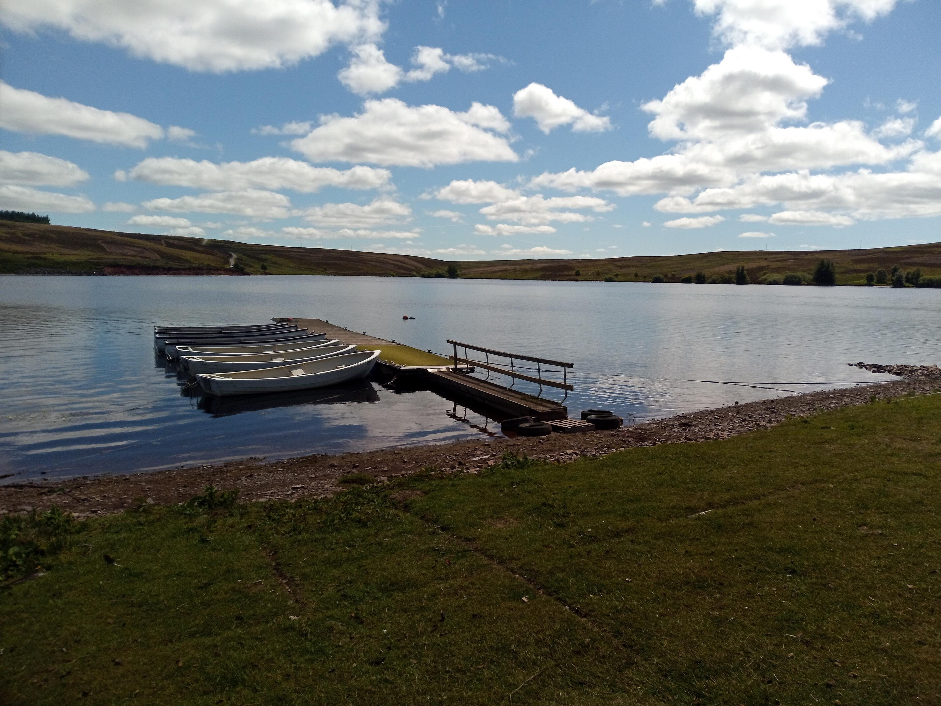
Private Water Supply Conference
4 September 2024
Rosemary Greenhill

Slide 2
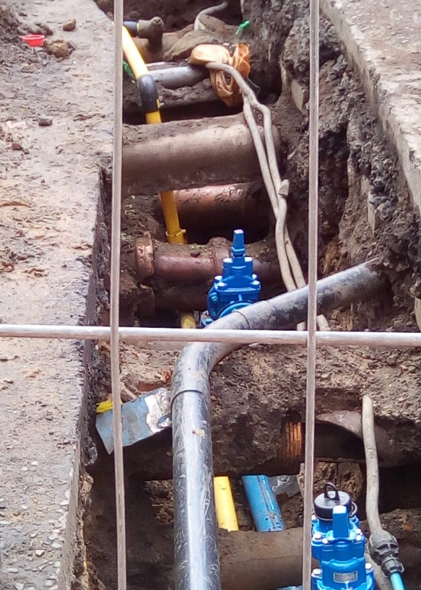
Recast Drinking Water Directive
Main Points of Interest - General
To recap:
Parameter Lists
Updated parametric values
New parameters added
Watch list added
Microplastics
Value for Lead halved to 5µg/l
Risk Assessments
Catchment Risk Assessments
Supply Risk Assessments
Domestic Distribution Risk Assessments with a focus on Lead

Slide 3
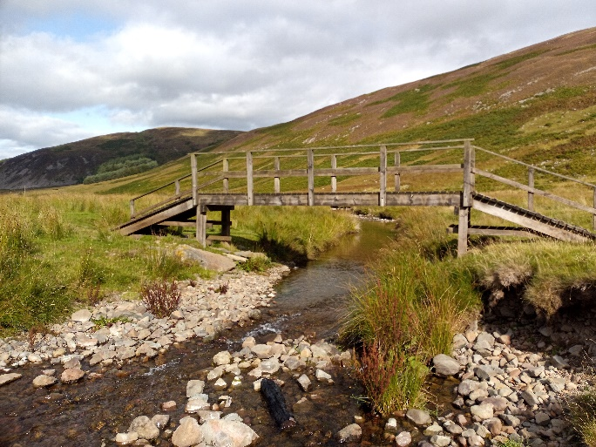
Recast Drinking Water Directive 1
Main Points of Interest - General
To recap:
Information to the public
Greater information relating to levels of consumption
Cost
Quality
Performance of large water suppliers (leakage, efficiency etc)

Slide 4
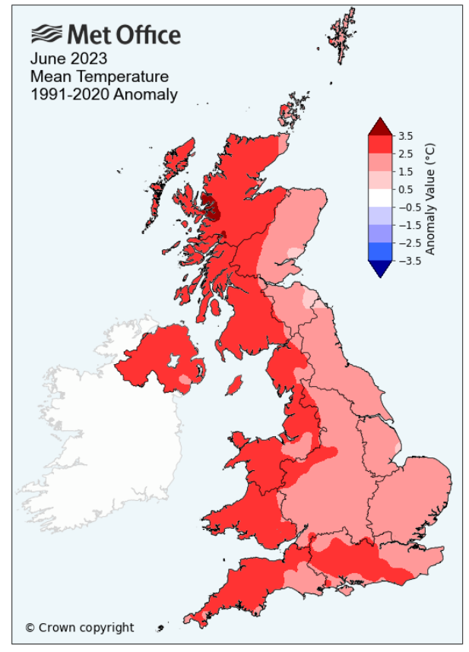
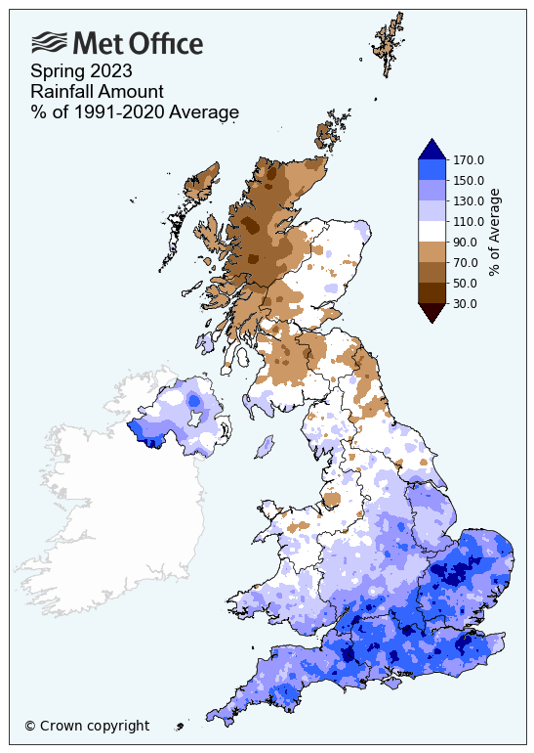
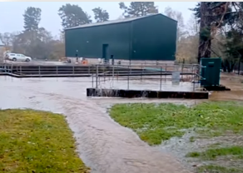
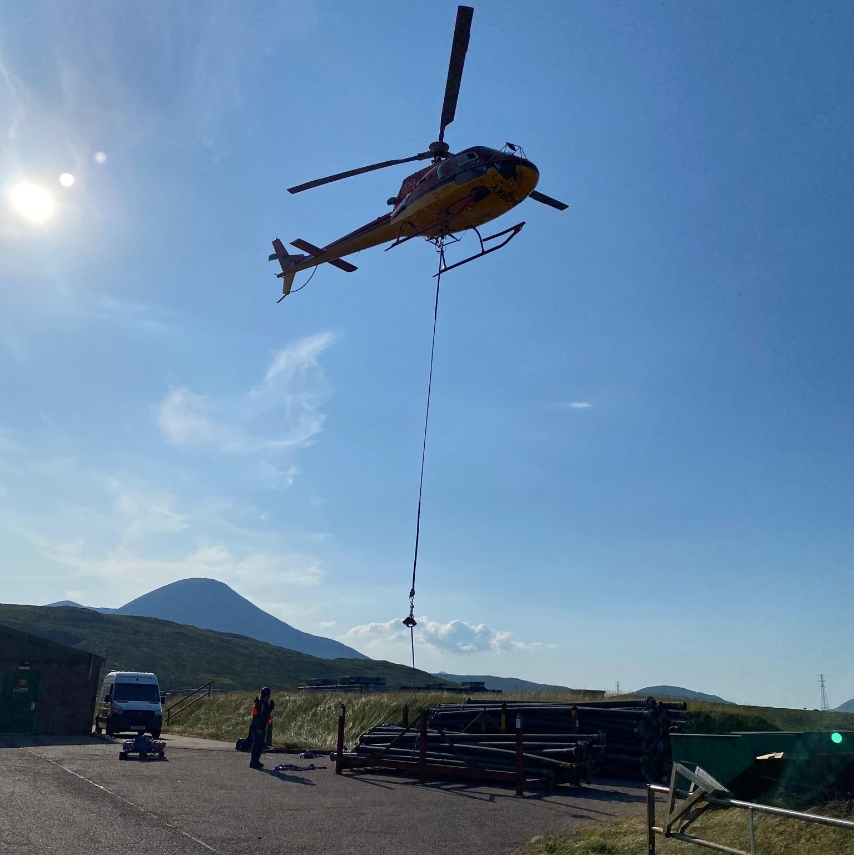
Challenges of climate change
Warmer temperatures and changing precipitation patterns are impacting on Scotland’s water environment.
Rainfall frequency, duration, intensity and total amounts are changing and snow accumulation and melting patterns are changing too.
In summer, Scotland is likely to see less rainfall over all and when it does rain storms are set to become more intense. We will have warmer, wetter winters with more periods of intense rain and less lasting snow.
Notes:
Climate Change is impacting services today and the impacts are increasing. (eg carron valley WTWs – algal blooms)
Resilience to enable adaptation is costly

Slide 5
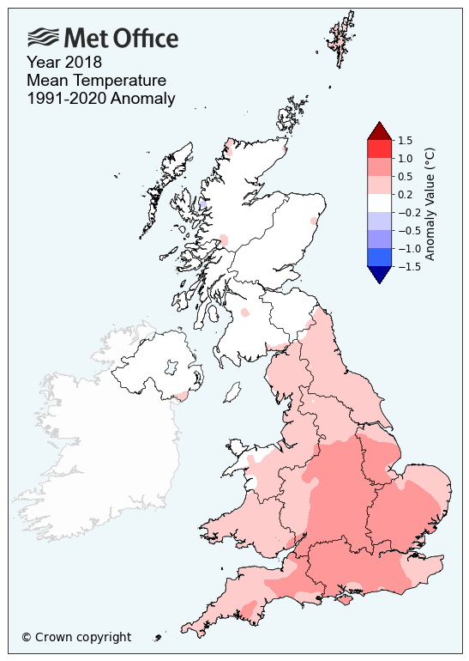
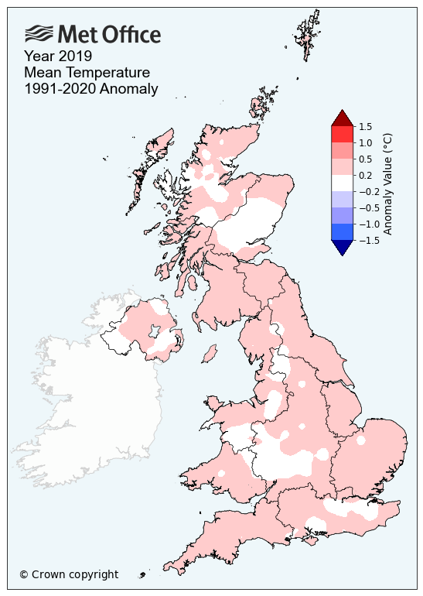
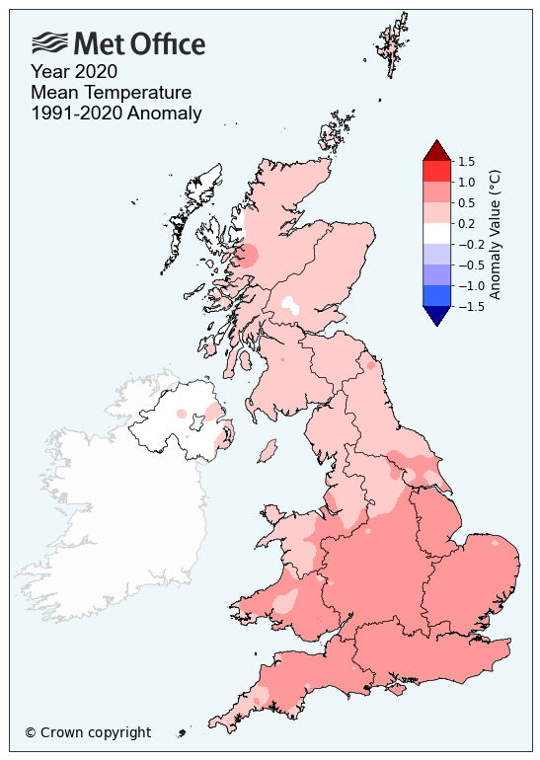
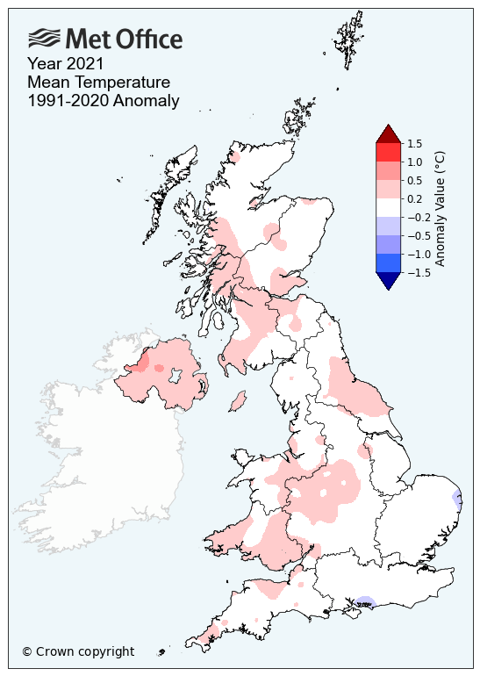
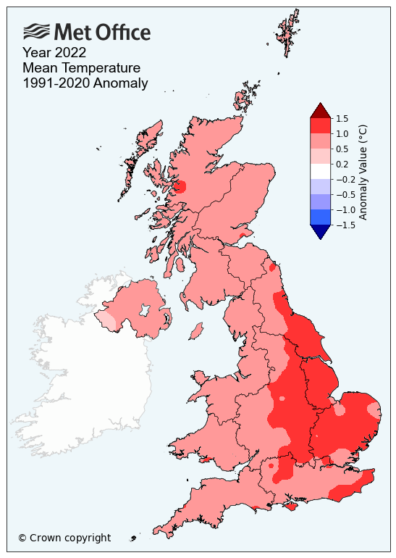
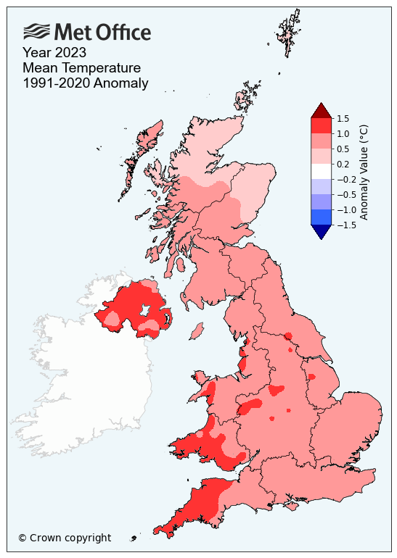
Mean Annual Temperature 2018-2023
What we're seeing:
Obvious overall warming trend
2023 was one of the warmest year on record

Slide 6
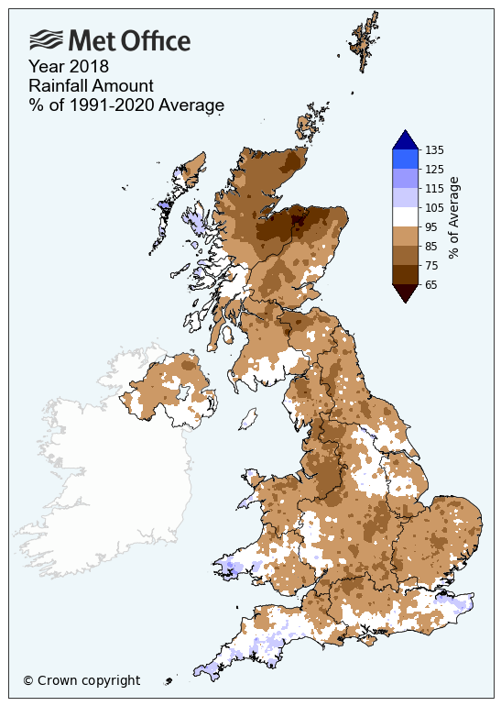
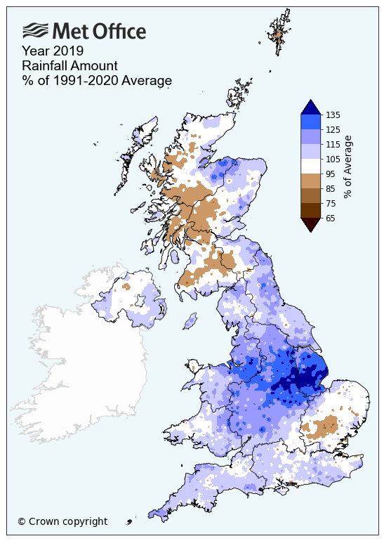
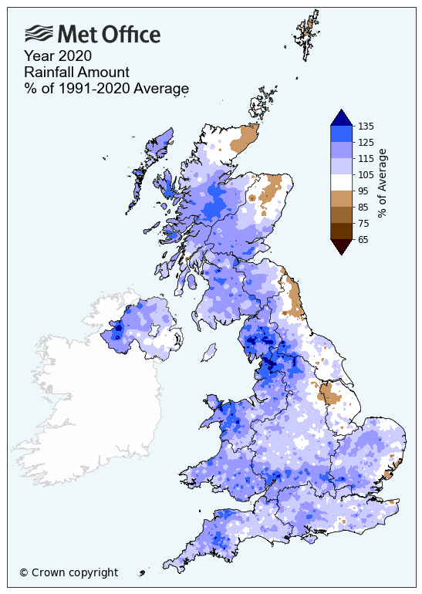
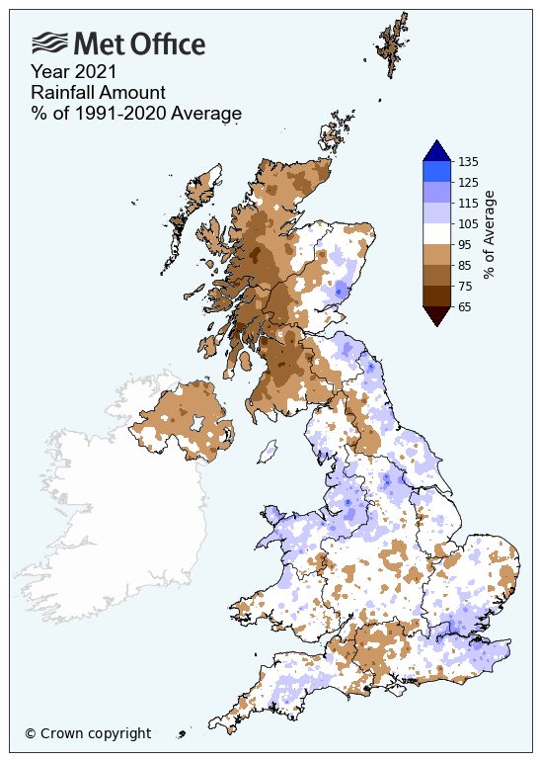
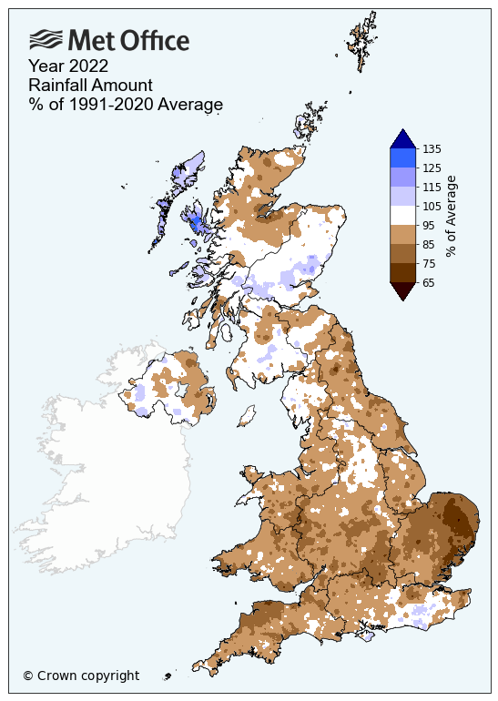
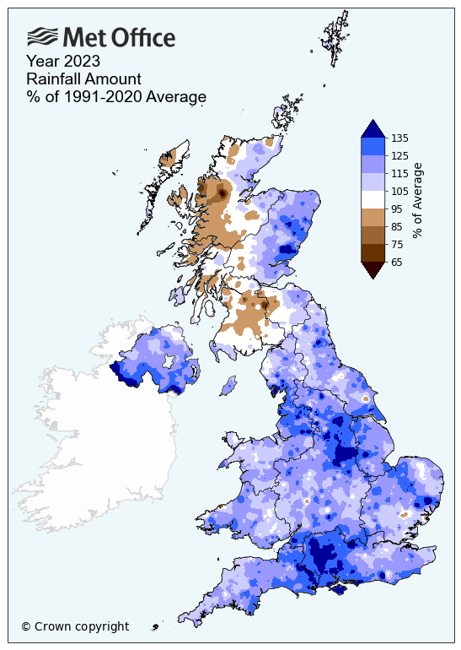
Mean Annual Rainfall 2018-2023
What we're seeing:
Extremes in dry and wet weather
Unpredictable nature of extreme rainfall events – variability east & west
2023 one of the wettest years on record

Slide 7
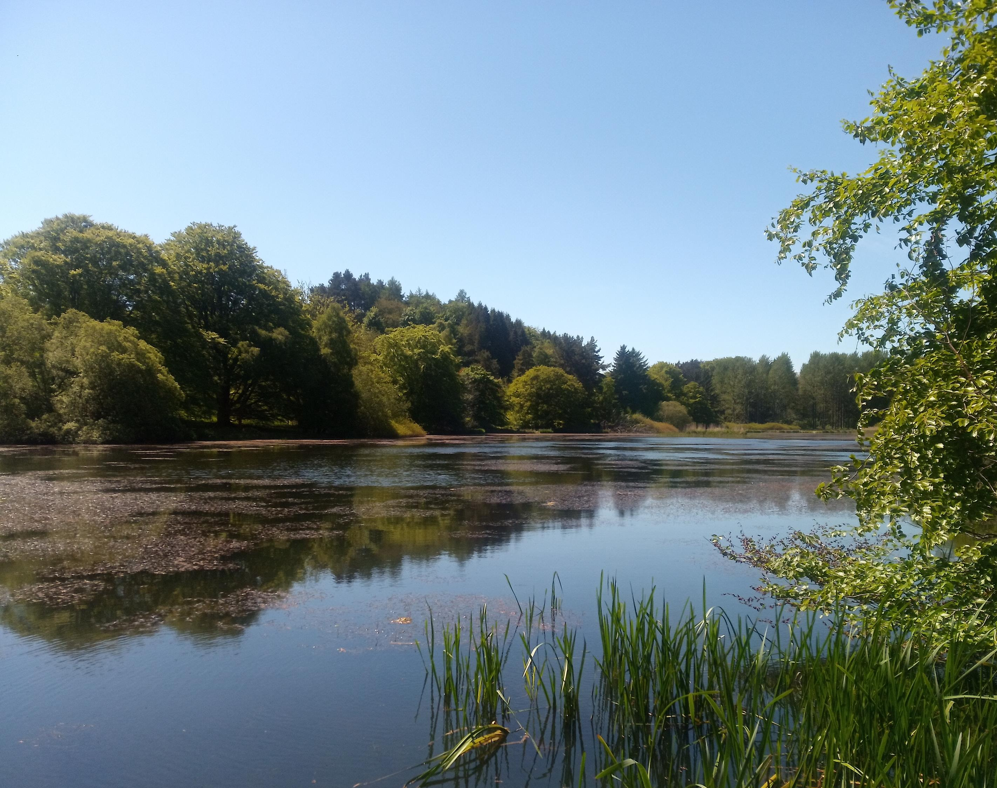
Consultation Analysis

Slide 8
492
responses
Notes:
How it was advertised:
Comms – Twitter, LinkedIn
Emails, industry newsletters, direct contacts – with thanks to our working group leads who spread the word
Engagement sessions – 13 formal engagement
Overview of Responses:
Developers/Property: Cala Ltd, Homes for Scotland, Scottish Property Federation, Builders Merchants Federation, SNIPEF (plumbing Employers Federation)
Environmental: Fisheries Management Scotland, FIDRA, SRA, Marine Conservation Society, Surfers against sewage, Scottish Environment LINK, Nature Scot
Agriculture & Forestry: NFU, Scottish Forestry, Forestry and Land Scotland
Councils: Midlothian, Falkirk, Edinburgh, Highland, South Ayrshire, North Ayrshire, Orkney, Aberdeen, Dumfries & Galloway, West Lothian, Dundee, Shetland. Perth & Kinross
PWS management/developing: HighWater (Scotland) Ltd
Health: Kidney Care

Slide 9
Private Water Supplies
Requiring registration on house sales
Requirement for home report to include details of PWS
They broadly agree with our proposals for drinking water, wastewater & drainage
Requirement for owners and users to register their PWS
Access to information and Certified training for owners and users for large supplies
Better mapping of PWS that is available publicly
Scotland-wide sampling service with standard costs

Slide 10
Water Resource Planning
The respondents broadly agree that:
A national view of catchment risks will help better protect drinking water sources from pollutants
Scotland needs a plan for managing its rainwater resources

Slide 11
Drinking Water - Availability
To what extent do you agree or disagree that everyone in Scotland needs to use less drinking water?
Would you like to know how much water you use in your home?

Slide 12
Drinking Water – Availability
How can businesses and individual use less water (415 responses):
Education: 26%
Metering: 24%
11 responses referred to metering for information only
3 responses referred to need for exemptions
Utilise greywater: 22%
Behaviour change at home: 20%
Rainwater collection: 20%
Water saving domestic appliances: 13%
Reducing leaks: 11%
To what extent do you agree or disagree that the process for responding to water shortages should be changed so that appropriate action can be taken as soon as it is needed?
Would you know where to find information on using less water (384 responses):
Scottish Water website: 25%
Online (but no specific location mentioned): 22%
Yes (but no specific location mentioned): 20%
Variety of websites and sources referenced – SEPA, Waterwise, energy Saving Trust, etc NGO websites

Slide 13
Drinking Water - Quality
To what extent do you agree or disagree that all of Scotland’s plumbing should be made lead-free?
Would you know where to get information on how to ensure that your pipes are not affecting your drinking water?

Slide 14
Drinking Water – Quality
What support do owners and users of private water supplies require to ensure that drinking water is safe? (360 responses):
Testing of private water supplies: 42%
Regular testing: 28 responses
Affordable or free: 35 responses
Home testing kits: 12 responses
More information & guidance: 24%
Owner/user responsibility to ensure that drinking water is safe: 6%
Other emerging themes: Need for financial help, Support service, Safeguarding catchment areas, Education & Support connecting to the mains supply
Do you agree that all drinking water supplies, regardless of size or ownership, should be tested and inspected to ensure that drinking water is safe?
Do you have further view on public and private drinking water supplies? (226 responses):
Education on demands on water services and need to reduce consumption
Upgrading infrastructure (reduce leaks & bursts, reservoirs)
Protect catchment areas
Reduce leaks
Behaviour change

Slide 15
Summary
Behaviour change is essential to using less water and limit charge rises
They agree that water resource planning is important
They broadly agree with our proposals for drinking water, wastewater & drainage
Respondents are willing to make changes
They require more information on what they can do to help and where they can go for support
They agree that we should recognise that there are three services
They generally do not think council tax is a fair way to charge for services

Slide 16
What Next?
The need for new legislation has been agreed and seen as essential
Bringing forward policy for decisions in September setting out key policies and EU Directive alignment considerations
Currently in discussion on timing of legislation coming forward
Consultation on more detailed legislative proposals and impact assessments will be required, and will include further engagement sessions with stakeholders

