Slide 1
Highland Private Water Supplies: Remote Locations
4 September 2024

Slide 2
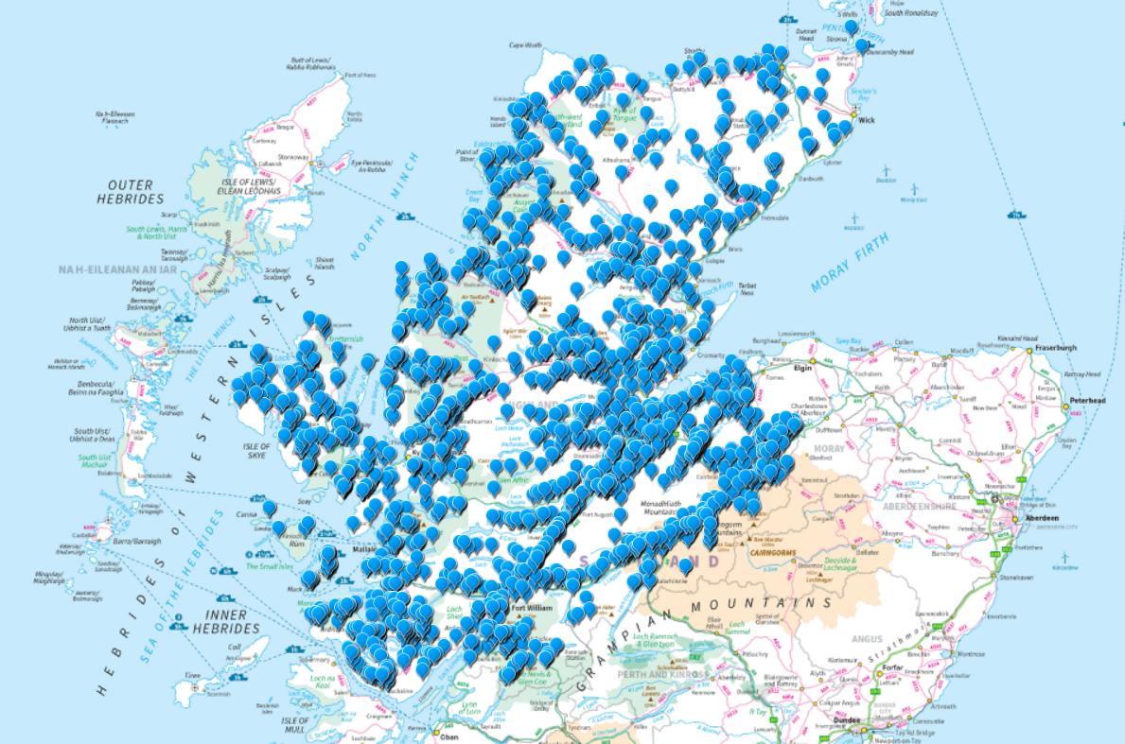
PWS in Highland
Regulated supplies:
1100
Access:
Vehicle, boat, bike, walk
Evelyn MacLennan. Technical Officer Environmental Health

Slide 3
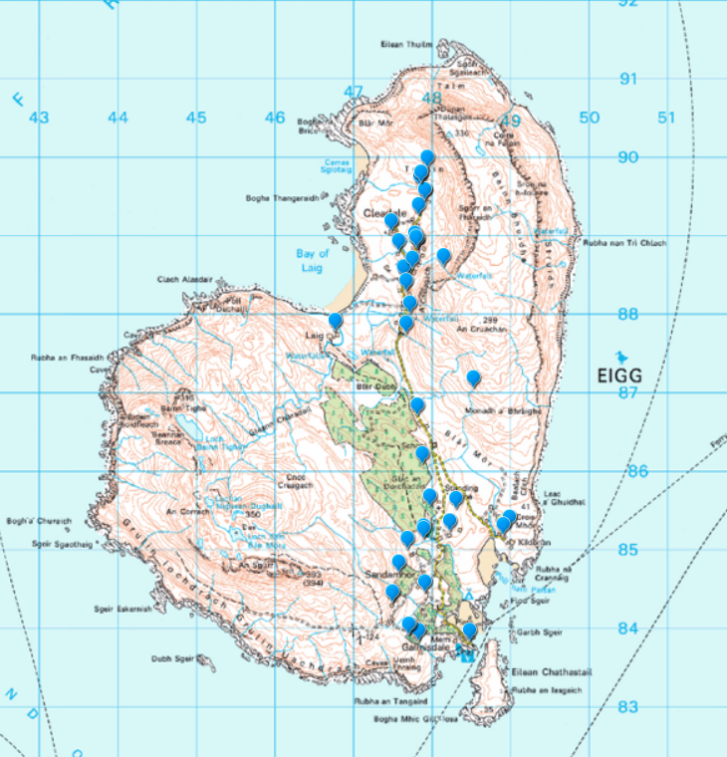
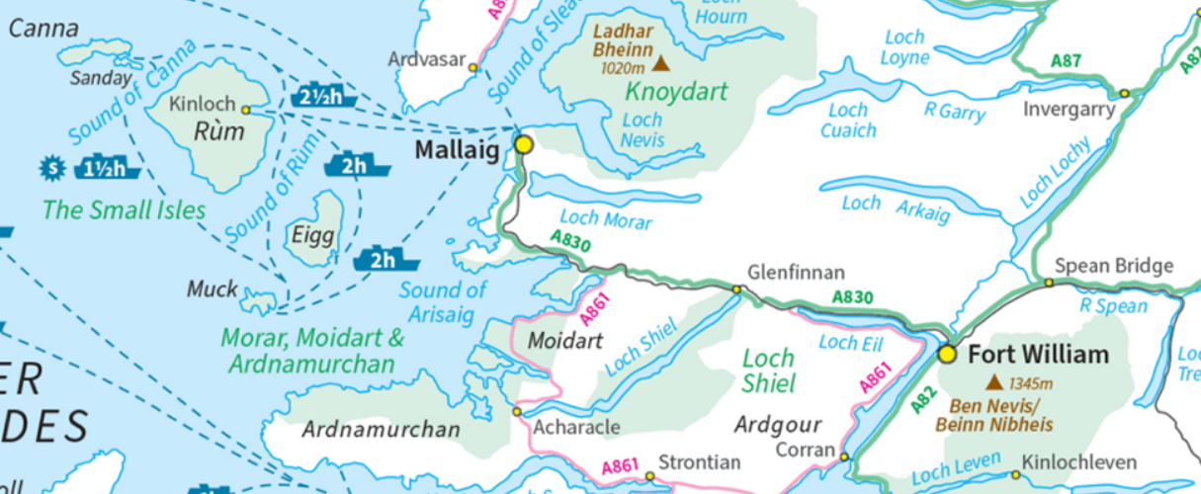
Isle of Eigg PWS 1
Evelyn MacLennan. Technical Officer Environmental Health

Slide 4
Isle of Eigg PWS 2
Population 83
42 PWS
24 Regulated
18 Exempt
Evelyn MacLennan. Technical Officer Environmental Health

Slide 5
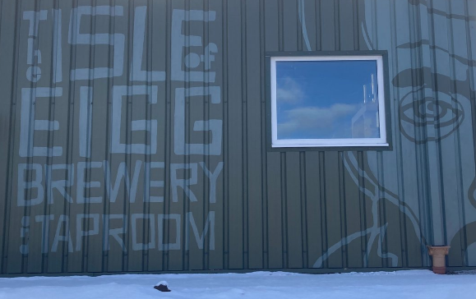
Isle of Eigg PWS 3
Types of Properties
Café / Visitor Centre / Shop
School
Brewery
Housing Association properties
Holiday Lets inc Yurts
B&B
Restaurant
Holiday Homes
Owner Occupied
Evelyn MacLennan. Technical Officer Environmental Health

Slide 6
Plan Island Trips for Summer Timetable
MONDAY
Eigg – 6 hours on island (1 hour 20 mins each way)
Rum – 3 hours on island (2 hours 45 mins each way)
Canna – drop off only
TUESDAY
Muck – 2 hours 20 mins on island (2 hours 20 mins each way)
WEDNESDAY
Eigg – 5 hours on island (1 hour each way)
Muck – 3 hours on island (2 hours each way)
Rum – 4 hours on island (1 hour 25 mins each way)
Canna – 2 hours 20 mins on island (1 hour 20 mins each way)
MONDAY – FRIDAY
Inverie – 4 hours on land (30mins on ferry each way) (mainland)
Evelyn MacLennan. Technical Officer Environmental Health

Slide 7
Isle of Eigg PWS 4
Organise Time on Island
Usually 2 officers for routine island visits
Factor in time to disembark & be back 30 mins before departure
Schedule sampling / RA taking into account distance from pier, source, condition of island roads and if walking
Co-ordinate locations to be time efficient
If doing Risk Assessment, prepare as much paperwork in advance as possible to save time on island
Evelyn MacLennan. Technical Officer Environmental Health
Notes:
Mark Herron - Rum

Slide 8
Isle of Eigg PWS 5
Organise Time on Island (cont.)
Contact each individual property owner
(Canna & Muck can arrange via 1 point)
Arrange driver & transport for each officer
(consider worthiness of driver & vehicle)
As time restricted, no time for lunch / break on island until possibly when waiting for return ferry
Repeat for fails
Evelyn MacLennan. Technical Officer Environmental Health

Slide 9
Isle of Eigg PWS 6
Typical Timings for Trip to Eigg
7:30
Arrive Office
8-8:15
Leave Office
Travel to Arisaig
(car - 1 hour)
10:00
Depart Arisaig
(ferry)
11:00
Arrive Eigg
16:00
Depart Eigg
(ferry)
17:00
Arrive Arisaig
17:30
Depart Arisaig
(car)
18:30
Deposit samples at Scottish Water depot
19:00
Return to office
Evelyn MacLennan. Technical Officer Environmental Health

Slide 10
Points to note when using ferries
Arrive at least an hour early for ferry
parking is difficult during summer & need time to organise and carry equipment to ferry
Carry all necessary equipment and personal necessities
eg food & water, waterproof clothing, etc
Book cool boxes onto ferry
Carry cool boxes and equipment from car to boat
Carry cool boxes with filled sample bottles from boat to car.
Max 3 boxes per officer
2 routine samples per box
max 12 routine samples per island visit
Evelyn MacLennan. Technical Officer Environmental Health

Slide 11
Extra points
Wear appropriate clothing
most suitable boats to islands and Knoydart are open to the elements
Ensure physical access to office at beginning and end of day
Ensure access to drop off samples at Scottish Water depot or arrange with courier
Pray for good weather but don’t forget the seasick pills!
Evelyn MacLennan. Technical Officer Environmental Health

Slide 12
Weather Conditions
Ferry may be cancelled at last minute
Boat may sail but not allow passengers to disembark on island
Once on the island, return trip may leave early or not happen if boat unable to dock so potentially stuck on island
Evelyn MacLennan. Technical Officer Environmental Health

Slide 13
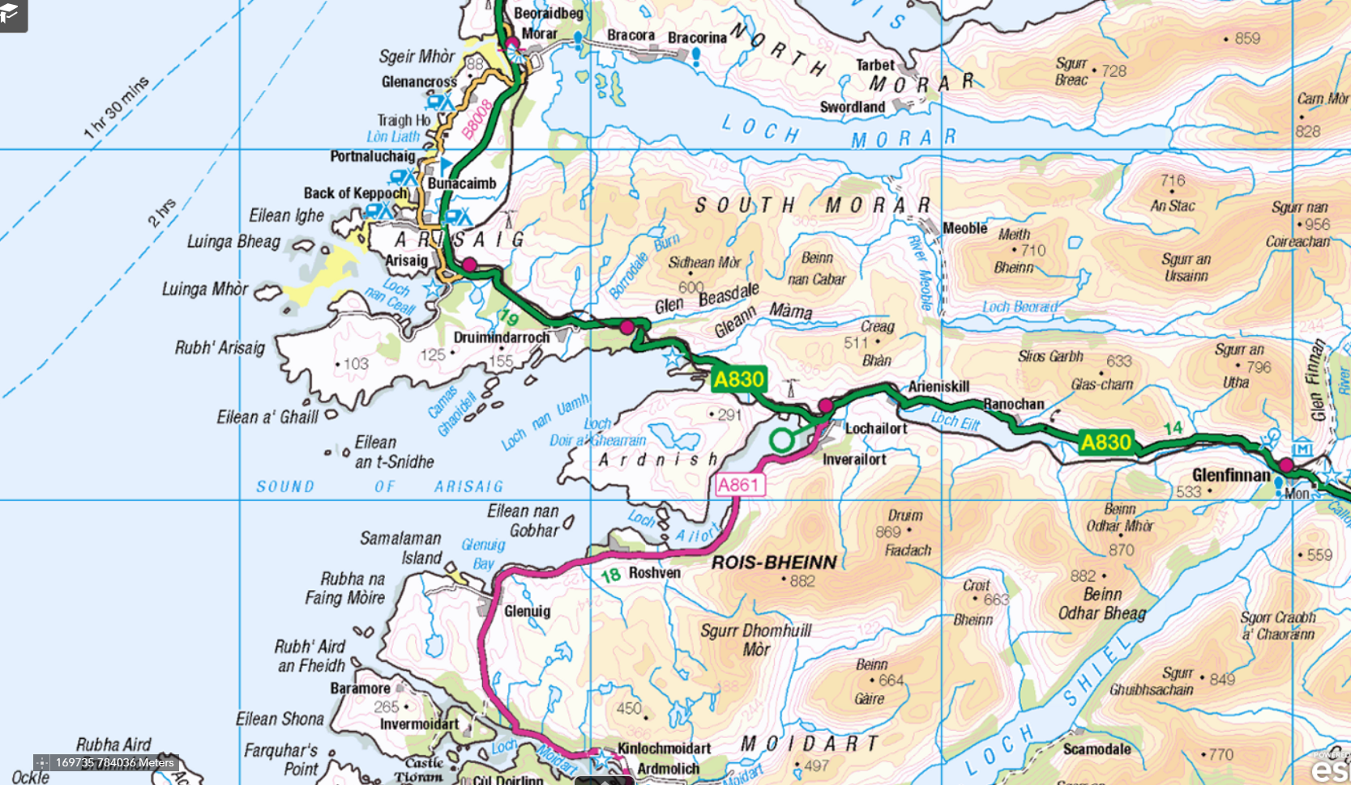
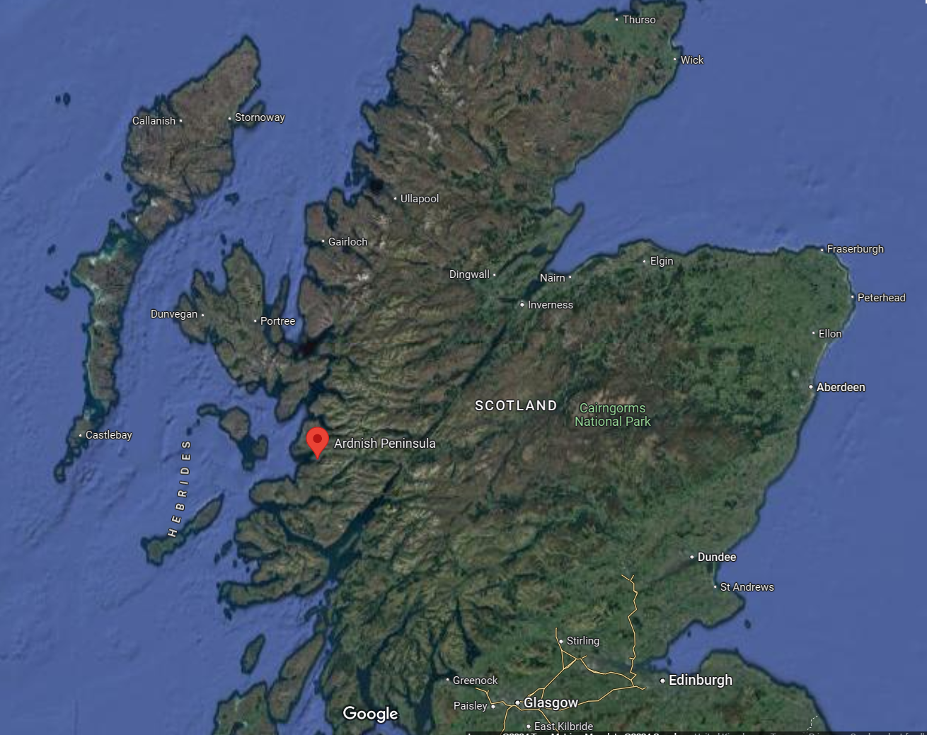
Laggan, Ardnish 1
Private Boat Charter
Evelyn MacLennan. Technical Officer Environmental Health

Slide 14
Laggan, Ardnish 2
Private Boat Charter
Evelyn MacLennan. Technical Officer Environmental Health

Slide 15
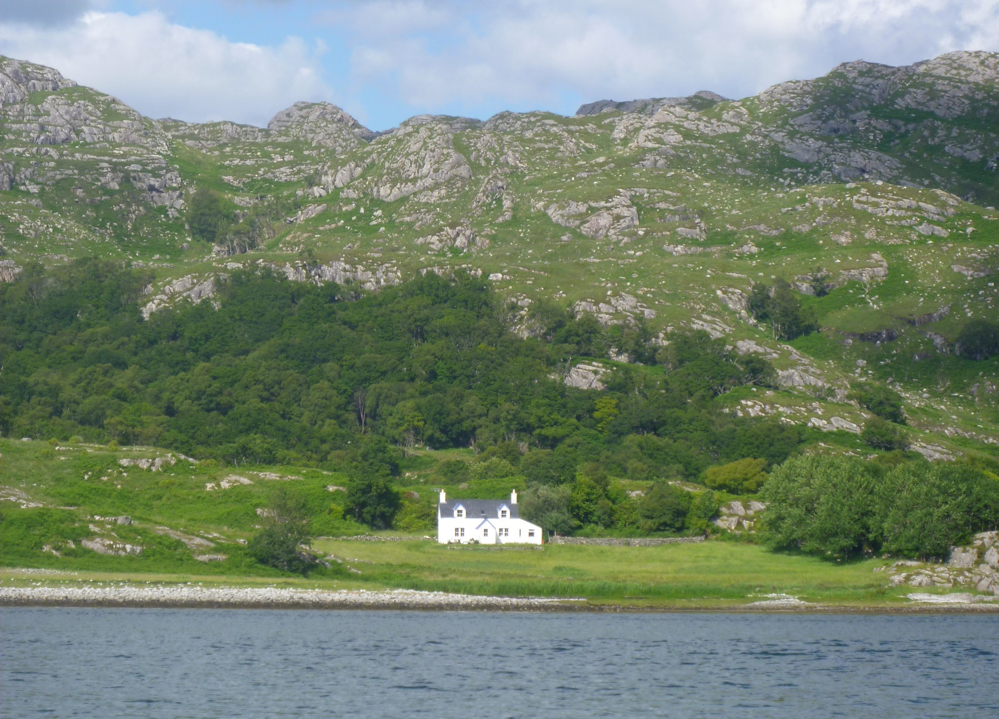
Challenges to sample from Laggan, Ardnish
4 miles from nearest road
2 ½ hour walk
Very rough track, challenging sections
Carry day pack and equipment
Cottage open May – September
Evelyn MacLennan. Technical Officer Environmental Health

Slide 16
Laggan, Ardnish 3
Overcome Challenges
Research which company will charter
Arrange date with property owner & confirm with boat
Arrange charter boat & payment (£600)
If tender needed for shallow bay, more expensive (£700)
Evelyn MacLennan. Technical Officer Environmental Health

Slide 17
Laggan, Ardnish 4
Sampling Day
Date & time determined by tides
Confirm day before tides and weather ok
Weather conditions may necessitate postponing
Evelyn MacLennan. Technical Officer Environmental Health

Slide 18
Laggan, Ardnish 5
12:15
Leave office
13:30
Arrive Arisaig Marine
14:00
Boat departs
17:45
Arrive back at Arisaig Marine
19:20
Arrive back at office
Sampling
Day
2024
Evelyn MacLennan. Technical Officer Environmental Health

Slide 19
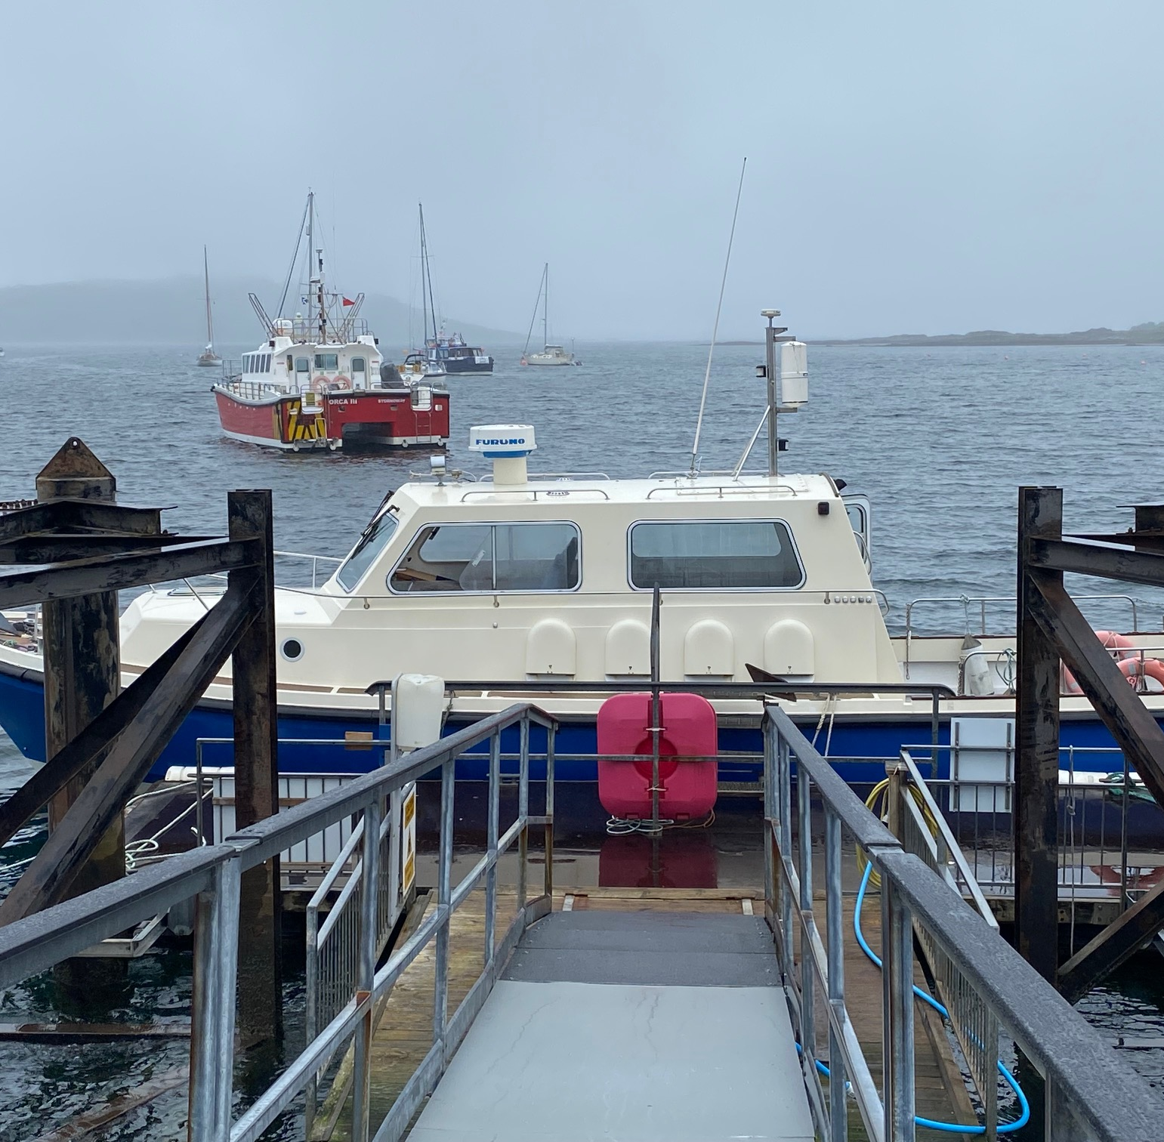
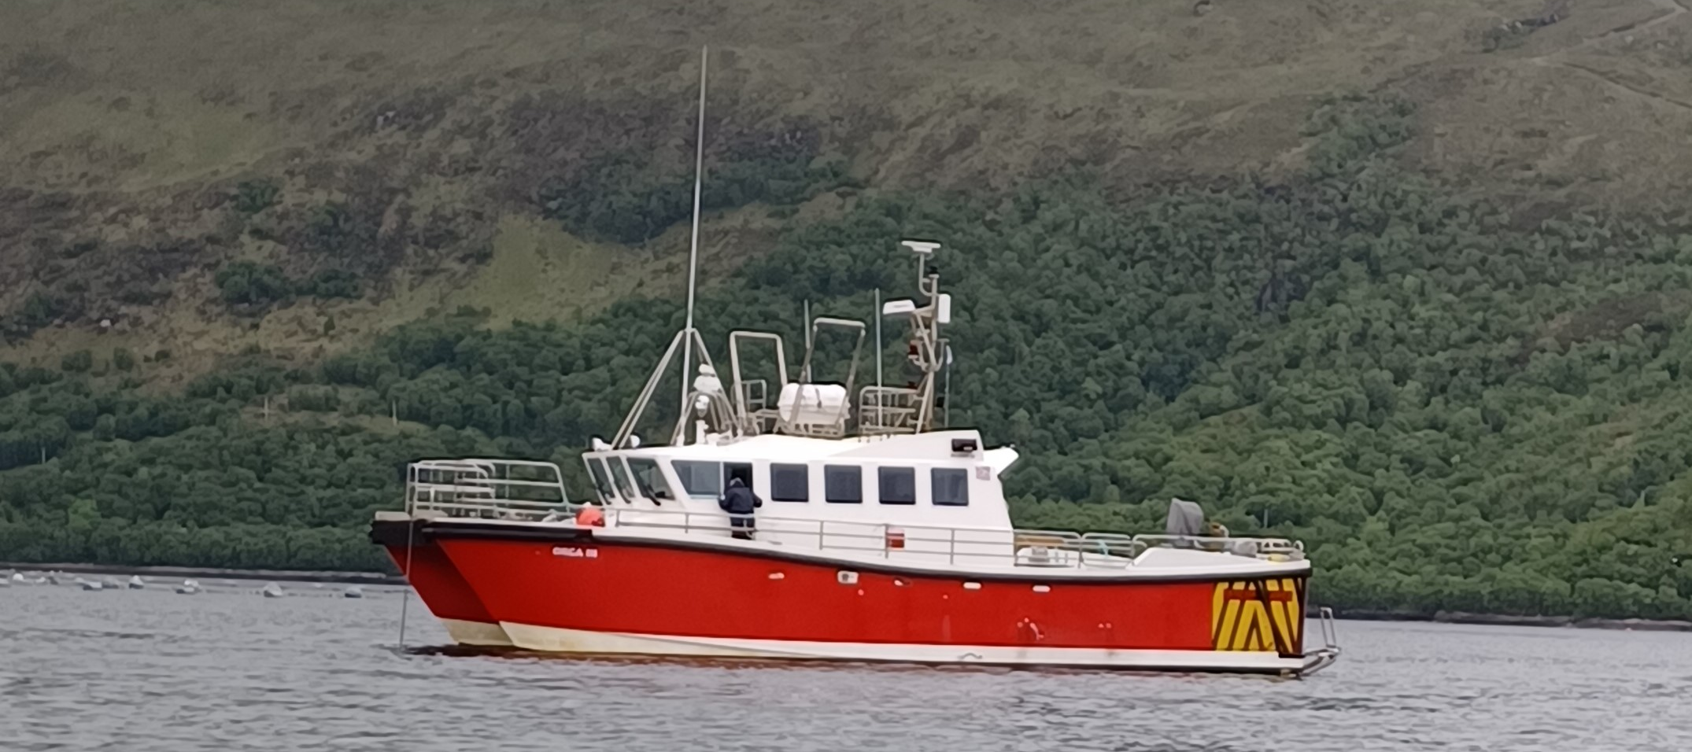
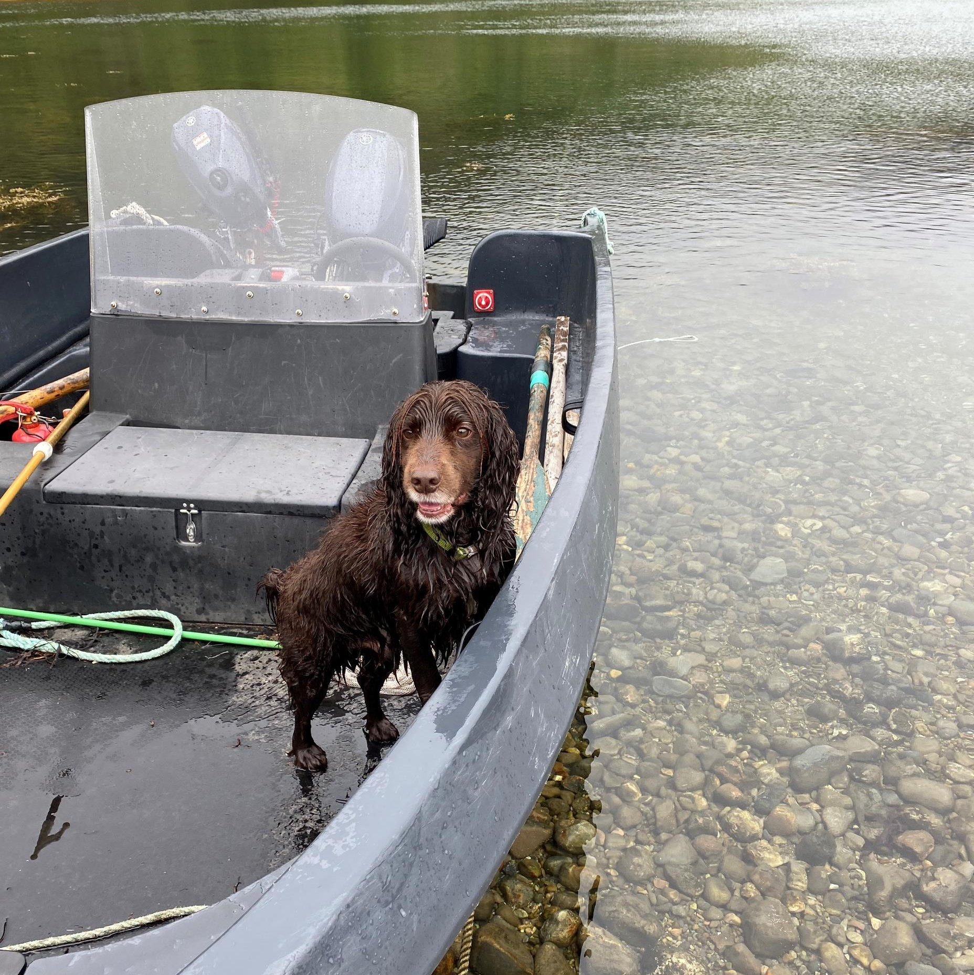
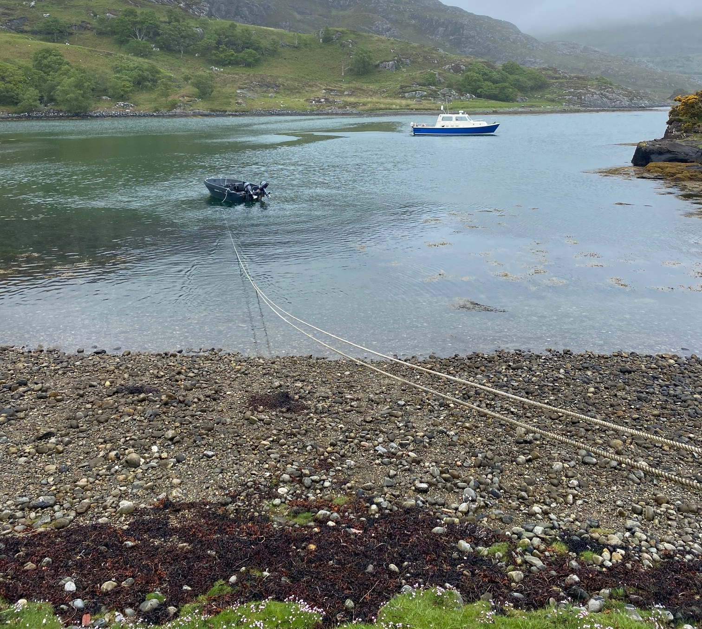
Charters from Arisaig to Laggan, Ardnish
Evelyn MacLennan. Technical Officer Environmental Health

Slide 20
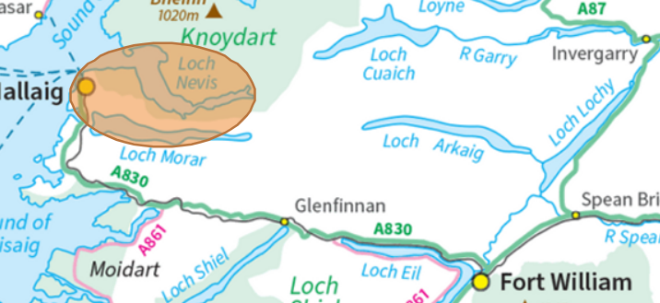
Some locations require more than one boat
Knoydart
Evelyn MacLennan. Technical Officer Environmental Health

Slide 21
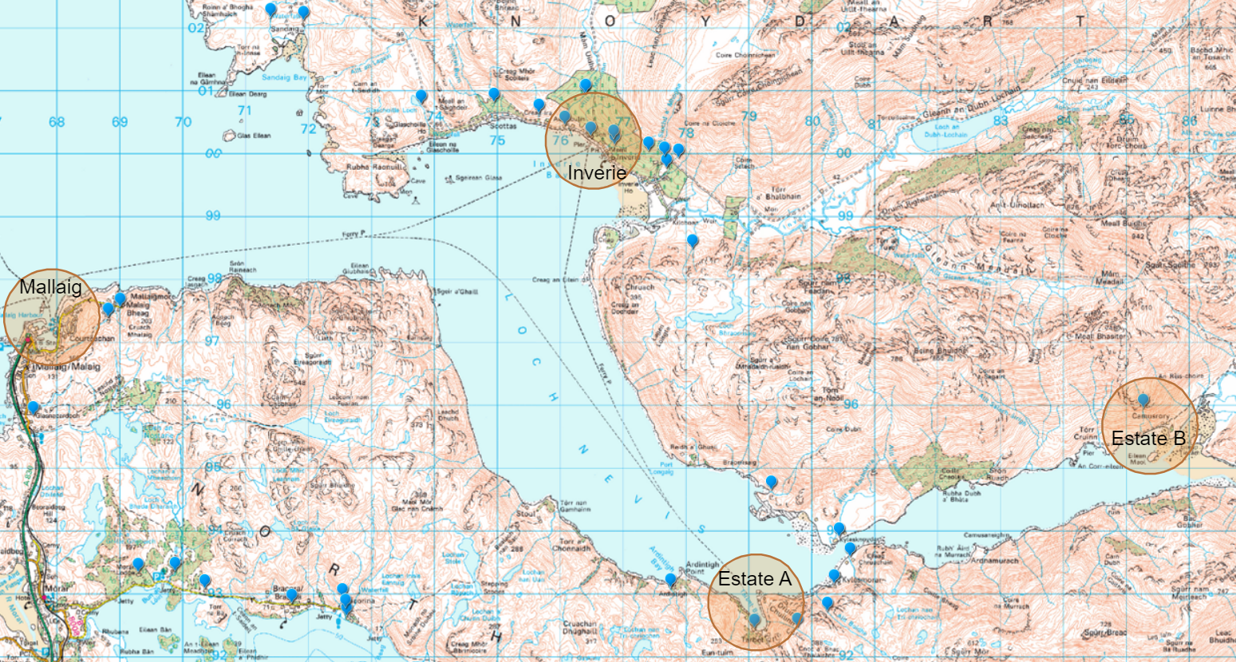
Knoydart
Some locations require more than one boat
1.
Ferry from Mallaig to Inverie
2.
Estate A boat from Inverie to Estate A
3.
Estate A boat to Estate B
4.
Estate B to either Inverie or Mallaig depending on timings
Evelyn MacLennan. Technical Officer Environmental Health

Slide 22
Highland PWS in remote areas
Whilst the islands are indeed remote, it must be remembered that the majority of PWS work is carried out on the mainland which may also be remote
A82 & A9 regularly closed due to accidents
No alternative route for A82
Summer - Huge influx of tourists with their hire cars and camper vans
Ardnamurchan peninsula (50 square miles) is on the mainland and accessed by Corran Ferry to avoid travelling an extra hour each way.
Winter – Stormy, snow & icy conditions
Majority of roads that we travel on are single track
Evelyn MacLennan. Technical Officer Environmental Health

Slide 23
Highland Council Boat Policy
No boat travel if boat or skipper unlicensed to carry work personnel
Restricted sampling and RA in locations inaccessible by vehicle
Challenges highlighted with 2017 requirement to RA
Magnified by Short Term Let applications
Looking for satisfactory solution
Patricia Sheldon, Senior Environmental Health Officer

Slide 24
Financial Considerations
Routine and follow up work (bacto or chemical failures)
Risk Assessments
PWS register continually expanding, especially with the addition of tenanted and Short Term Let properties (STL)
Boat hire costs v budget
Patricia Sheldon, Senior Environmental Health Officer

Slide 25
Financial Questions to Consider
Should councils charge relevant person full cost of travel?
Where no option but to use a private boat charter
DWQR / Scottish Government:
Consider a means for LA to claim back boat charter fees associated with statutory obligations?
Annual LA PWS Grant Regulations claim:
Can charted boat costs be reclaimed if grant processed?
Patricia Sheldon, Senior Environmental Health Officer

Slide 26
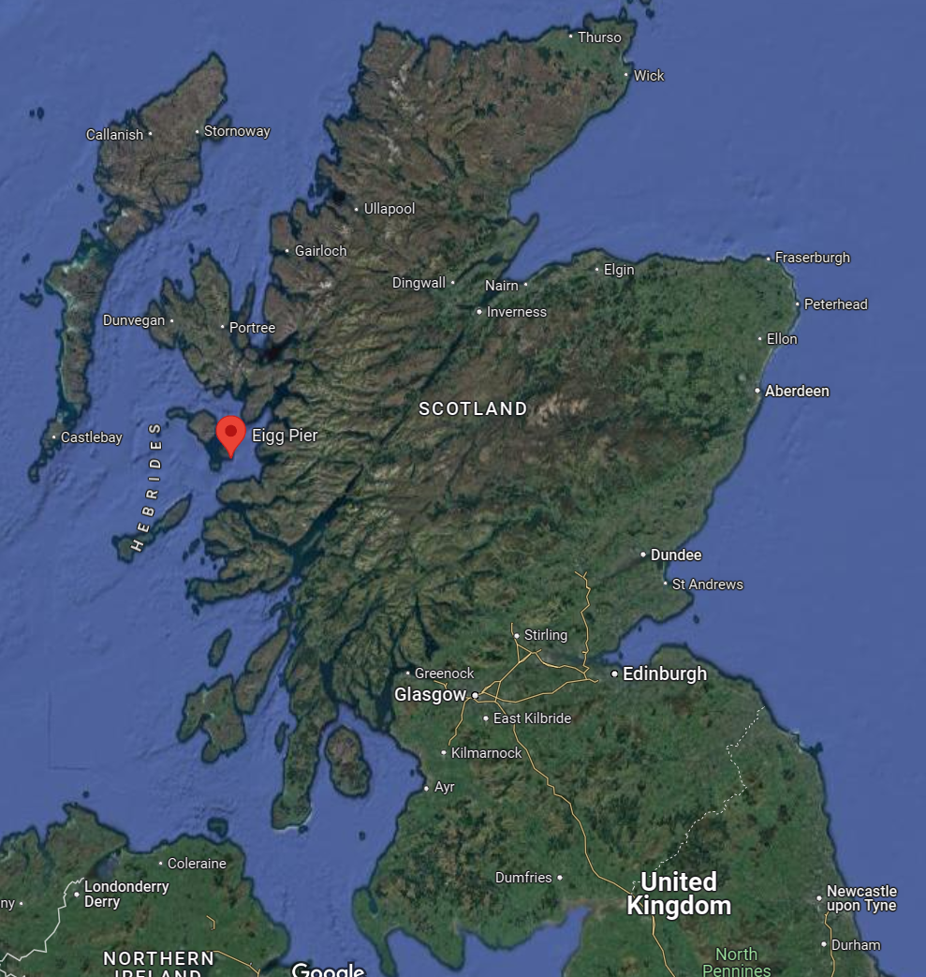
Comparisons:
Distance:
Inverness to Glasgow~280 km (175 miles)
Ayr to Manchester ~358 km (222 miles)
Glencoe to John O Groats ~316 km (196 miles)
Area:
Dumfries & Galloway 6,426 km²
Aberdeenshire 6,313 km²
Lochaber is a 4,648 km² (1 of 8 districts in Highland)
Highland Council 26,484 km²
Population density: people per km²
Scottish average 70
Highlands and Islands 12
Western Isles 9
Lochaber 1.7 (excluding the main town of Fort William)
Evelyn MacLennan. Technical Officer Environmental Health

Slide 27
Fun Facts:
The Highland Council makes up
1/3 of Scotland land mass
1/4 of UK coastline is in Highland Council area
2/3 of Local Authority’s are in the central belt
Evelyn MacLennan. Technical Officer Environmental Health

Slide 28
t

