Slide 1
Raw Water Supplies A Little Piece of History
Matt Bower

Slide 2
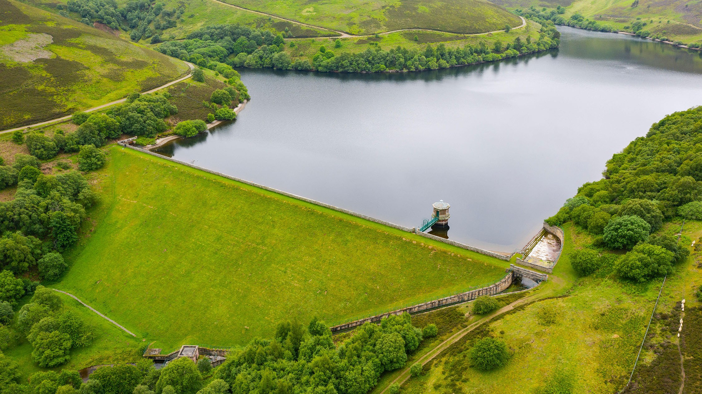
SW Raw Water Sources

Slide 3
SW Raw Water Sources 1
662

Slide 4
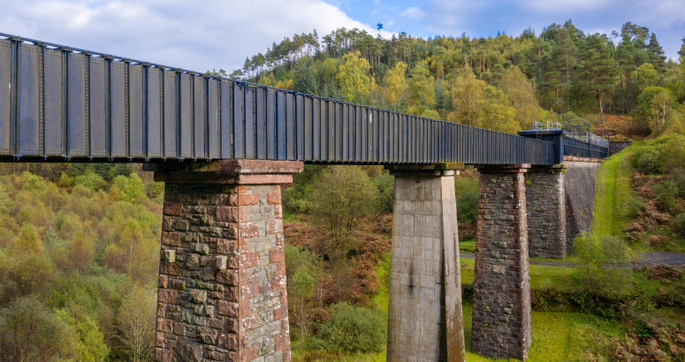
SW Raw Water Sources 2

Slide 5
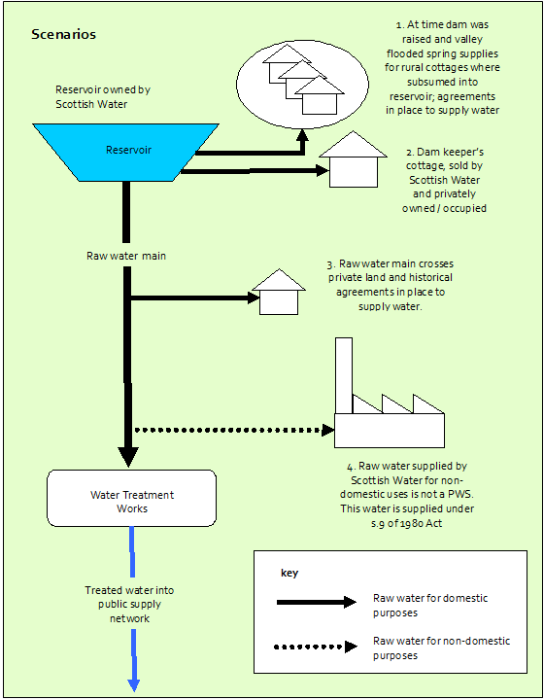
“Could we just lay this pipe across your land..?”

Slide 6
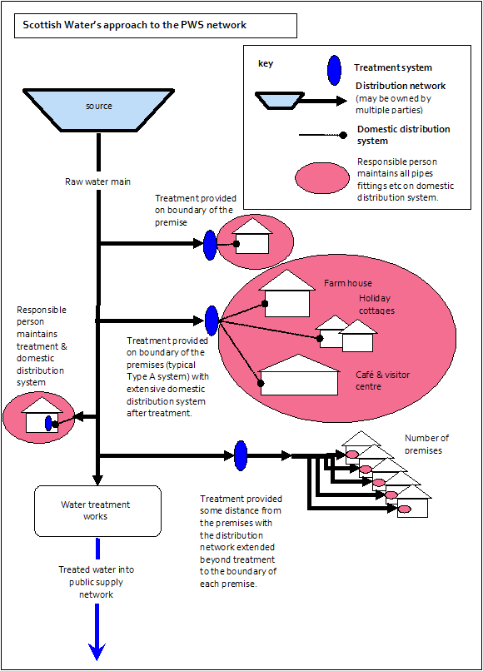
Sw approach to PWS Networks

Slide 7
The 2017 PWS Regulations do not apply to: (a) water introduced into, or supplied through or from, any part of the public water supply system, including water supplied by Scottish Water pursuant to an arrangement under section 6(1)(b) of the Water Services etc. (Scotland) Act 2005, (b) water supplied by Scottish Water by any other means, including from a tanker or in bottles or containers, and (c) water supplied with the help of services provided by Scottish Water, as described in section 30 of the Water Industry (Scotland) Act 2002. For the purposes of this definition a public water supply system is defined in section 28 of the Water Services etc (Scotland) Act 2005 as any and all of the mains and other pipes, water treatment works and other similar infrastructure which are (either or both): (a)vested in Scottish Water; or (b)used by Scottish Water (or a person acting on its behalf or under its authority) in connection with the exercise of Scottish Water's core functions as respects the supply of water.

Slide 8
The 2017 PWS Regulations do not apply to: (a) water introduced into, or supplied through or from, any part of the public water supply system, including water supplied by Scottish Water pursuant to an arrangement under section 6(1)(b) of the Water Services etc. (Scotland) Act 2005, (b) water supplied by Scottish Water by any other means, including from a tanker or in bottles or containers, and (c) water supplied with the help of services provided by Scottish Water, as described in section 30 of the Water Industry (Scotland) Act 2002. For the purposes of this definition a public water supply system is defined in section 28 of the Water Services etc (Scotland) Act 2005 as any and all of the mains and other pipes, water treatment works and other similar infrastructure which are (either or both): (a)vested in Scottish Water; or (b)used by Scottish Water (or a person acting on its behalf or under its authority) in connection with the exercise of Scottish Water's core functions as respects the supply of water.

Slide 9
Implications
All Raw Water Supplies:
Are the responsibility of SW
Must be regulated via the Public Water Supply regulations
Must meet the quality standards set out in the regulations
Must be risk assessed

Slide 10
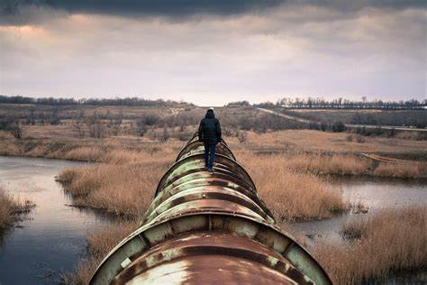
Implications 2
DWQR Requested SW bring supplies up to standard
May cover several investment periods
“Letter of Commitment” requested

Slide 11
In the interim
Public Health MUST be Protected
Risk assess all supplies to prioritise
Sample at least annually
Protect consumers until supply upgraded

Slide 12
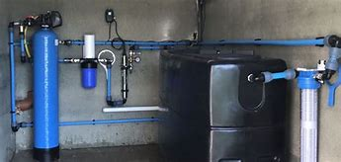
What Does this mean for LAs?
No longer PWS – LAs do not need to RA or sample
Please support SW in taking ownership
Provide Information
Supplies should not fall “between gap”

Slide 13
Thank You
(Questions?)

