Slide 1
Private Water Supplies Connections Project
Hollie Armstrong
Scottish Government
Drinking Water Policy

Slide 2
DRAFT
What?
Why?
How?
Programme for Government 2021/22
Allocated capital funding (spent across parliamentary term between 22/23 – 25/26)
To tackle the impacts of water scarcity and build long-term resilience of PWS to climate change
Establish a programme to extend or upgrade the public water network to allow shortlisted PWS to pay for a connection
To tackle the impacts of water scarcity and build long-term resilience of PWS to climate change
Who?
Where?
Led by Scottish Government in partnership with Scottish Water, Consumer Scotland and Local Authorities
Led by Scottish Government in partnership with Scottish Water, Consumer Scotland and Local Authorities
Piloted in Aberdeenshire and rolled out across Scotland

Slide 3
Over the current parliamentary term (2021 – 2026), funding will be invested in:
Initially, piloting five projects in Aberdeenshire where water impact assessments were carried out to allow Scottish Water to better understand the feasibility and costs of connections
Connecting shortlisted pilot communities in Aberdeenshire who are acutely affected by water scarcity, and who are willing to pay for a connection to the public water main
Established a two-year programme of water impact assessments across Scotland to better understand network constraints in rural areas and to assist in shortlisting further communities that are eligible for connections
Connecting further PWS communities in the subsequent years of the funding period following results of WIA programme

Slide 4
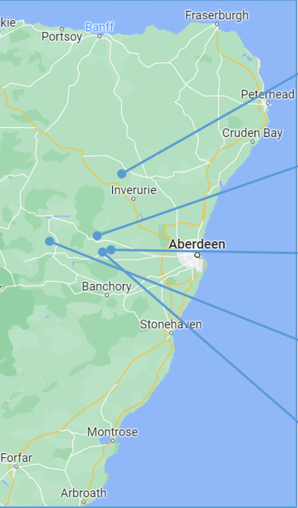
Lessons Learned
Initially, piloting five projects in Aberdeenshire where water impact assessments will be carried out to allow Scottish Water to better understand the feasibility and costs of connections
Water Impact Assessments
Criteria
Water Scarcity
Distance from mains
Indicative cost to extend mains network
Cottown Methlick
15 properties
£400k
There is capacity in the network to connect all 5 pilot communities – a surprise!
Possible unintended consequences > all candidates to be taken by recommendation from local authority
2 of 5 groups can connect without any further work – financial barrier removed
Assessments take time so need rolling programme
Tillyfourie
3 properties*
£110k
*56 can connect without extension
Comers, Midmar
24 properties
£1.3m
Milton of Cushnie
65 properties
£2.7m
Tillybirloch
7 properties

Slide 5
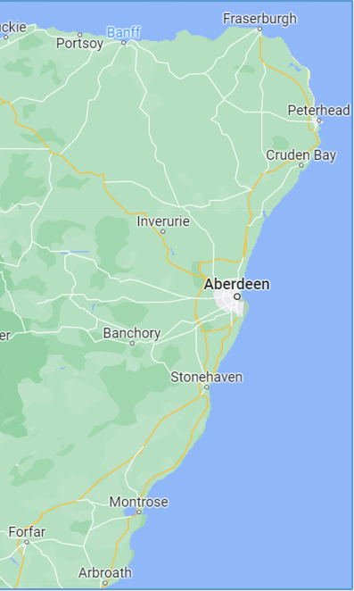
How?
Connecting shortlisted pilot communities in Aberdeenshire who are acutely affected by water scarcity, and who are willing to pay for a connection to the public mains
Shortlisted for Connection
£50k per property threshold applied
Approaching the Communities
Assess willingness to connect
Cottown Methlick
15 properties
£400k
£26.6k pp
Develop comms strategy
Engage and understand willingness of community to pay for connections – many variables
Next steps
Tillyfourie
3 properties
£110k
£33.3k pp
Barriers
Milton of Cushnie
65 properties
£2.7m
£27k pp
Community cohesion and co-ordination
Financial barriers for connections

Slide 6
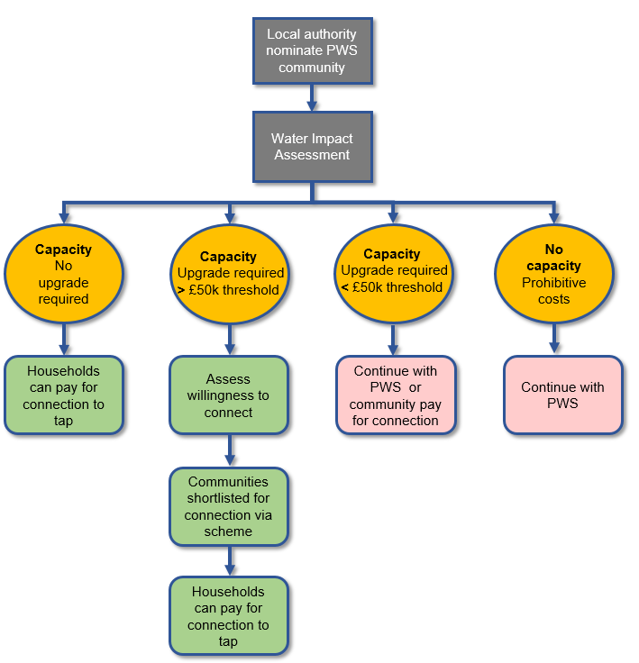
Journey
Established a two-year nationwide programme of water impact assessments to better understand network constraints in rural areas and to assist in shortlisting further communities that are eligible for connections
What are WIA’s?
Nominated by LAs
First step in making connections
Does network have sufficient capacity to accommodate the demands of new consumers?
What work is required and how much will it cost?
Benefits of WIA’s
Removes speculative cost barrier – WIAs costs range from £3k – £25k
Provides definitive answers to communities – is connecting a viable option?
Assists Scottish Water in handling future connection requests

Slide 7
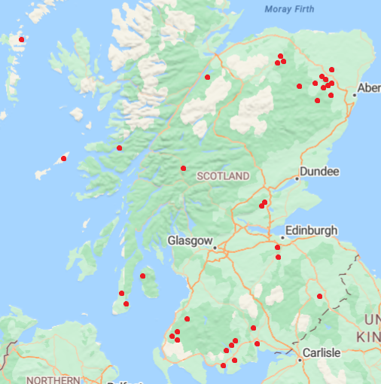
Project Stats
Connecting further PWS communities in the subsequent years of the funding period following results of WIA programme
Shortlisted for Connection
£50k per property threshold applied
Strontian, Highland
37 WIA
nominations
9 projects proceeding
Strathdon, Aberdeenshire
Newton of Corsindae,
Aberdeenshire
£10 million
allocated
Meikle Seggie, Perth and Kinross
£5 million more (we hope)
Upper Tillyrie,
Perth and Kinross
2 projects started
Bridge of Orchy,
Argyll ad Bute

Slide 8
What we hope to learn
Households will still be required to fund the connection across their land.
Will aid long-term decision making for PWS communities and the resilience measures required
How to support households connect to tap
Capacity of rural networks
What selection criteria to apply
What do we hope to learn?
Impact of removing speculative cost barriers
Was the criteria applied in the pilot fair and effective?
May allow many communities understand if mains connection is a viable option without any further action
How to assess community willingness to connect
How to approach PWS communities
Community willingness will determine whether an investment is made in the network
Valuable information on how to engage and the types of discussions that take place will inform the next stages

Slide 9
Thank you!

Slide 10
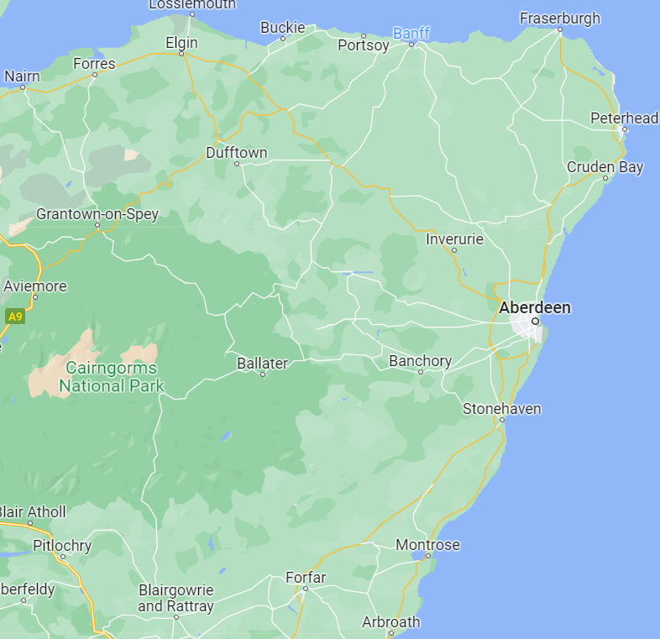
Recommendations
Water Scarcity:
Private Water Supply
First Time Connections Poject
Purpose: to begin a programme to connect communities reliant on PWS that are affected by water scarcity to public water mains.
*There is a wide variation in Scottish Water’s indicative costs, reflecting the length of mains required and geography. The majority of these are below £50k per property. This does not include costs of laying supply pipes across private land between houses and the water mains as this falls to the householder. Given work already completed to map PWS against water mains, we are aware of numerous properties in close proximity to existing water mains which should also fall within the £50k threshold.
Programme for Government 2021/22
Allocated £20m capital funding (£5m per year from 2022/23 – 2026/27)
Indicative cost to extend mains network*
Cottown Methlick
15 properties
£400k
A cost threshold of £50k per property is set to ensure the number of connections is maximised.
Three projects proceed to the next phase and that the majority of the £5m budget for 2022-23 is re-profiled across 2023/24-2026/27.
A two-year programme should be put in place to carry out Water Impact Assessments (WIA) for further communities across Aberdeenshire and other regions based on Local Authorities’ recommendations.
Tillyfourie
59 properties
£110k
A press release announced the funding and pilot scheme on 1 June 2022
Comers, Midmar
24 properties
£1.3m
£40k has been spent to date on the Water Impact Assessments.
The outturn for this year is likely to be under £500k.
Milton of Cushnie
65 properties
£2.7m
Sensitivities
It is likely that there will be requests for financial assistance to install the private supply pipe to properties.
Tillybirloch
7 properties
TBC
Further investigation required
whether there is scope to provide assistance in the case of hardship.

Slide 11
Water Scarcity: Private Water Supply - First Time Connections Project
Water Impact Assessments Results
Recommendations
Timeline
Indicative cost to extend mains network
Cottown Methlick
15 properties
£400k
A cost threshold of £50k per property is set to ensure the number of connections is maximised.
Water Impact Assessments
Water Scarcity
Distance from mains
April - September
Tillyfourie
3 properties*
£110k
*56 can connect without extension
Three projects proceed to the next phase and that the majority of the £5m budget for 2022-23 is re-profiled across 2023/24-2026/27.
Shortlisted for Connection
£50k cost per property threshold applied
Comers, Midmar
24 properties
£1.3m
September - October
Milton of Cushnie
65 properties
£2.7m
A two-year programme of Water Impact Assessments for further communities across Aberdeenshire and other regions based on Local Authorities’ recommendations.
Approaching the Communities
Assess willingness
Proceeding with connections
Tillybirloch
7 properties
TBC
October – April?
Spend
£40k spent to date on the Water Impact Assessments
Outturn for year is likely to be under £500k
Sensitivities
Likely to be requests for financial assistance to install the private supply pipe to properties.
Further investigation required
Is there scope to provide assistance in the case of hardship?
Next Steps
Comms strategy
Public information on project
WIA programme list

Slide 12
Recommendations
Timeline
A cost threshold of £50k per property is set to ensure the number of connections is maximised.
Water Impact Assessments
Water Scarcity
Distance from mains
April - September
Three projects proceed to the next phase and that the majority of the £5m budget for 2022-23 is re-profiled across 2023/24-2026/27.
Shortlisted for Connection
£50k cost per property threshold applied
September - October
A two-year programme of Water Impact Assessments for further communities across Aberdeenshire and other regions based on Local Authorities’ recommendations.
Approaching the Communities
Assess willingness
Proceeding with connections
October – April?
Spend
£40k spent to date on the Water Impact Assessments
Outturn for year is likely to be under £500k
Sensitivities
Likely to be requests for financial assistance to install the private supply pipe to properties.
Further investigation required
Is there scope to provide assistance in the case of hardship?
Next Steps
Comms strategy
Public information on project
WIA programme list

Slide 13
ACTION
Local authority nominate PWS community
Result
Water Impact Assessment
Outcome
Capacity
No upgrade required
No capacity
Prohibitive costs
Capacity
Upgrade required
> £50k threshold
Capacity
Upgrade required
< £50k threshold
Households can pay for connection to tap
Assess willingness to connect
Continue with PWS or
community pay for connection
Continue with PWS
Communities shortlisted for connection via scheme
Households can pay for connection to tap

Slide 14
Continue with PWS
Local authority nominate PWS community
Water Impact Assessment
Capacity
No upgrade required
No capacity
Prohibitive costs
Capacity
Upgrade required
< Cost threshold
Capacity
Upgrade required
> cost threshold
Households can pay for connection to tap
Selection and design of the mains upgrade for each community
Continue with PWS or
community pay for connection
Assess / promote community willingness to connect
Households can pay for connection to tap

