Slide 1
Treatment – Membranes
Matt Bower
DWQR Risk Assessment Training
2018

Slide 2
Membranes – Overview 1
Extremely fine, modular filter
Useful for removing range of things from water
Choice of membrane depends on application
Not maintenance free!
Range of filtration pore sizes
Turbidity, microbiology, chemical contaminants

Slide 3
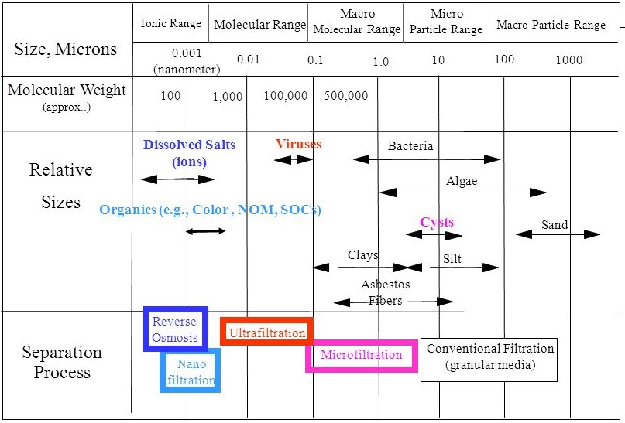
Membranes – Overview 2

Slide 4
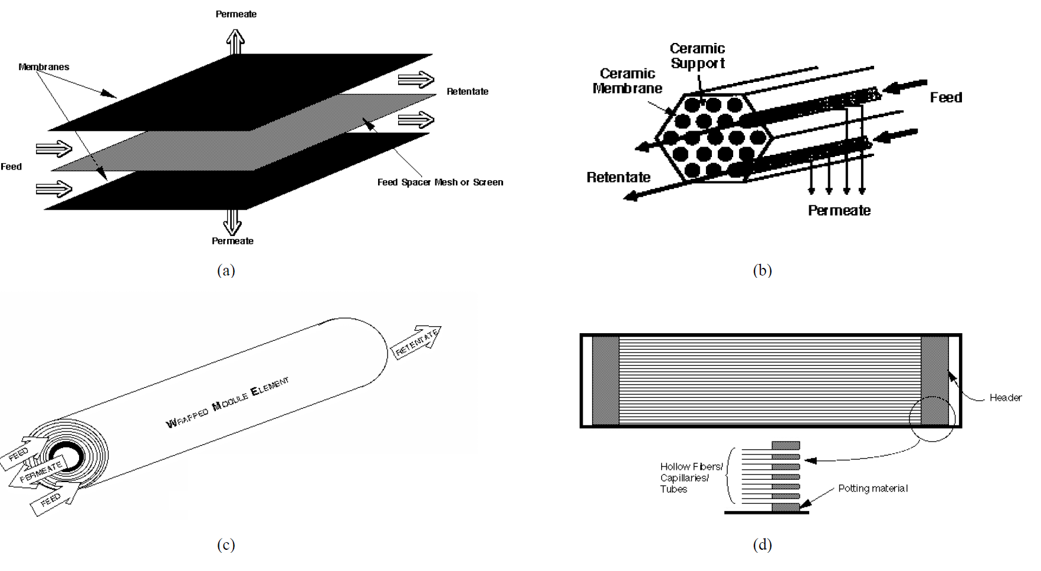
Membranes – Overview 3
Plate and frame / flat sheet b) Tubular
c) Spiral Wound d) Hollow Fibre

Slide 5
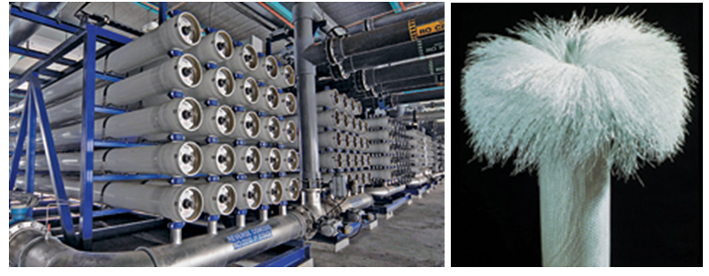
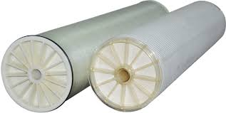
Membranes – Overview 5

Slide 6
Membranes – on PWS 1
Microfiltration
Solids
Bacteria (possibly)
Algal cells (but maybe not toxins / tastes)
Crypto
Colloidal turbidity – clay etc
Ultrafiltration
Nanofiltration
Most colour - but select pore size specification carefully
THM precursors
Reverse Osmosis
Chemiclals
Next module……

Slide 7
Membranes – on PWS 2
Bacteria (possibly)
Algal cells (but maybe not toxins / tastes)
Crypto
Colloidal turbidity – clay etc
Ultrafiltration

Slide 8
Key Points to Watch For
Pre-treatment –membrane will block otherwise
Are spares kept?
Is there a plan for inspection / replacement of membranes?
Cleaning – as per manufacturer
How would a membrane breach be noticed?
may involve chemicals (NaOCl, Citric acid….)

Slide 9
Questions
Code | Question | Notes | Risk Score
TMF1 | Is membrane plant specification/design inadequate for raw water quality? | The raw water quality at each site will determine the required design of the membrane plant depending on the nature of the water quality challenge. The manufacturer will recommend specific design characteristics and pore sizes for the membranes to remove specific chemical or microbiological contaminants. Ask for evidence that the membrane plant is site-specific. The raw water quality on each supply will determine the filter type, number and size (e.g. 1 micron, 5 micron, etc) depending on the nature of the water quality challenge. The installer should specify this based on quality characteristics of the source water. Ask the owner of the supply if they have details of this specification. (Does this belongs in the top box??) | 5
TMF2 | Could lack of pre-treatment cause membrane fouling and damage? | The integrity of the membrane is critical to ensure effective treatment. Therefore the presence of an appropriate pre-treatment is essential to protect the membrane against chemical (e.g. salinity), microbiological, aesthetic contamination or insufficiency of the supply. Pre-treatment must be adequate to prevent fouling and scaling, as well as protecting the membranes from physical damage. There should be suitable protection/screens to neutralise pre-treatment oxidants. Ask the owner to demonstrate, with suitable documentation, that the pre-treatment is adequate. The operator should provide procedures and records of the operation and monitoring of the membrane to check for integrity. Records should also be kept when membranes are replaced, including when ruptured or damaged. | 5
TMF3 | Are the cleaning regimes (for descaling and antifouling, etc.) inadequate or undocumented? | Check the membrane's design manual requirements for specification of the cleaning (antifouling and descaling) regime. The operator should provide evidence to demonstrate compliance with this manual. Any chemicals used in the treatment stage should be specified by the manufacturer and the operator should be asked for evidence that the correct chemicals are in use. The use of incorrect chemicals could cause membrane damage. Records should be kept to record cleaning and other maintenance. | 5
TMF4 | Are the chemicals used in the cleaning process incorrect or stored incorrectly? | Check the membrane's design manual requirements for specification of the cleaning (antifouling and descaling) regime. The operator should provide evidence to demonstrate compliance with this manual. Any chemicals used in the treatment stage should be specified by the manufacturer and the operator should be asked for evidence that the correct chemicals are in use. The use of incorrect chemicals could cause membrane damage. | 5
TMF5 | Could a loss of membrane integrity go undetected? | If the membrane is breached it will not provide a reliable barrier. How would this be picked up? Some membranes have integral automatic detection systems, but other systems may rely on monitoring or sampling. The appropriate integrity monitoring system will depend on the type of membrane and water quality - specialist advice should be sought. | 5
TMF6 | Could failures occur due to membranes not being replaced as per the manufacturer's specifications? | The manufacturer will specify the frequency at which the filters should be replaced. Ask for evidence that this is being adhered to. Membrane elements need to be handled with care and manufacturers' specifications should be followed closely. | 5

