Slide 1
Treatment – Ion Exchange Filters
Matt Bower
DWQR Risk Assessment Training
2018

Slide 2
Overview
Useful for removing a specific contaminant
Not cheap, or low maintenance
Sometimes only option for hard to remove ions
Available for organics removal…..Effective?
Swaps one ion for a less problematic one

Slide 3
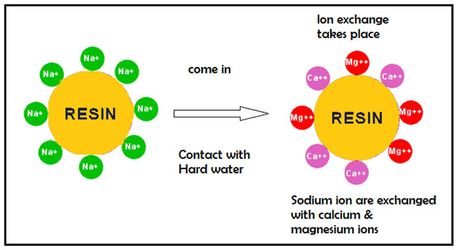
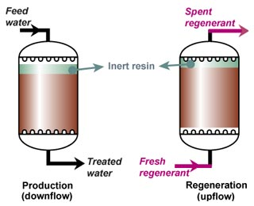
Overview 1
Swaps positively charged ions in water for sodium
Anionic resins also available
Can be ion-selective
Resin can be regenerated with NaCl (replaces sodium ions, contaminant goes into waste stream)

Slide 4
Usage on small water supplies 1
Most metals (Cationic)
All regenerate with brine
Smaller units may have self contained, automated regeneration
Nitrate (Anionic)
Various sizing options
May need to keep brine topped up
Single use cartridges available

Slide 5
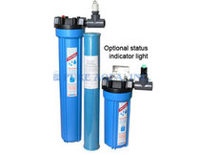
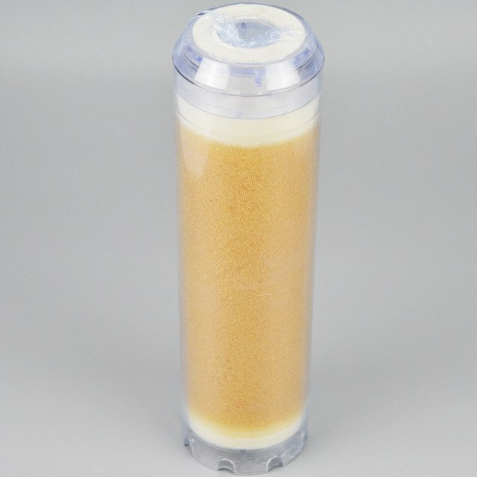
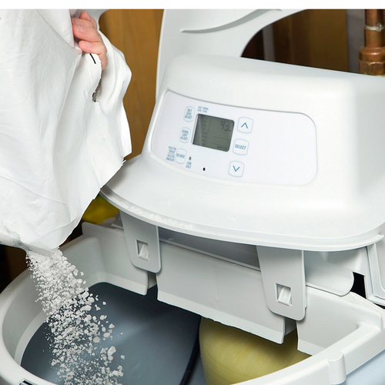
Usage on small water supplies 2

Slide 6
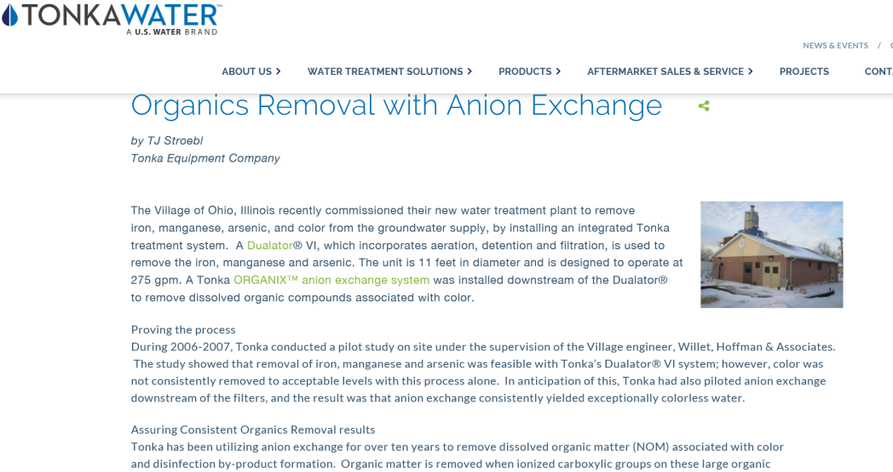
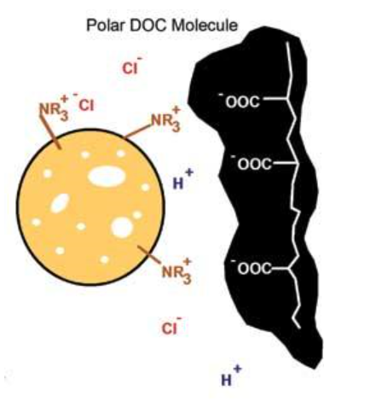
NOM / Colour Removal 1

Slide 7
NOM / Colour Removal 2
“Hit and Miss”
“Pitfalls”

Slide 8
NOM / Colour Removal 3
Interesting potential but need specialist advice
“Hit and Miss”
“Pitfalls”

Slide 9
Things that should be getting checked
Incoming / outgoing contaminant concentration
Brine concentration
Resin condition
Regeneration frequency

Slide 10
Key Points to Watch For
Ion exchange resins can foul if pre-treatment inadequate
Suitable disinfection process needed downstream
How does user know when resin / cartridge needs replacing?
Is there blending?
Is unit correctly sized for flow and max contamination?
Iron
Manganese
Biological
Sediment / peat
resin long-lived but not indefinite
How often does regeneration occur (is it automated?)

Slide 11
Questions
Code | Qusetion | Notes | Risk Score
TIE1 | Could inadequate pre-treatment lead to fouling of the resin? | Water needs to be relatively clean to enable the ion exchange resin to perform effectively. Dissolved minerals such as iron and manganese can also precipitate on the media, preventing its effective operation. Treatment prior to the ion exchange filter is usually required and needs to be effective. | 4
TIE2 | Is monitoring of the process inadequate? | In order for the process to operate effectively, it is vital that performance is monitored and understood. In particular, ion exchange resin needs to be regenerated periodically, and the regeneration frequency needs to be determined by careful monitoring. | 4
TIE3 | Could inadequate capacity cause quality problems? (both chemical and hydraulic considerations?) | The treatment process needs to be sized appropriately for the water flow required. If water flows too quickly through the filter, the contact time may be inadequate to fully treat the water. Similarly, if there is insufficient capacity within the filter, not all contaminants may be removed. | 4
TIE4 | Is there a risk that instructions for the filter operation and maintenance, including resin regeneration, are undocumented? | Ion exchange is a chemical filter and will eventually become exhausted and in need of regeneration. The rate of exhaustion will depend upon the amount of colour or other contaminants in the water and the flow rate through the filter. This breakthrough is difficult to predict, hence careful monitoring is required. | 4
TIE5 | Is the resin not regenerated in accordance with manufacturers' instructions? | Regeneration of ion exchange resin is a complex process which needs to be undertaken in accordance with the manufacturer's guidelines. Failure to do so may mean that the resin does not perform effectively over a period of time. | 4
TIE6 | Is there a risk that regeneration brine may not be correctly made up and / or checked? | Ion exchange resin needs to be regenerated with salt solution (brine). This needs to be of the correct concentration to be effective - the concentration may need to be monitored manually, or the system may do this automatically. | 4
TIE7 | Is there a risk that an inappropriate grade of salt may be used? | The salt used to make up the brine should be of food grade and suitable for use with the system installed. High concentrations of bromate can be an issue in some salts. | 4
TIE8 | Could an inadequately sized & operated backwash cause resin bed compaction? | Ion exchange resin will gradually become compacted due to water flowing through it in one direction. The backwash needs to be sufficient to expand the resin bed and reduce the compaction, otherwise the filter will gradually block. The backwash flow required should be documented on site. | 4
TIE9 | Could recycled backwash or regeneration water present a risk to quality? | Appropriate arrangements should be made to dispose of backwash and regeneration waters which may be contain salt and other chemicals. | 4
TIE10 | If treated supply is blended with other water, could this be inadequately controlled? | In some circumstances, only part of the water stream may be treated and blended with the remainder of the flow to achieve the desired concentration of contaminant. Where this is the case, clearly the required blend needs to be documented and carefully controlled so that the treated water remains within specification in all circumstances. | 4

