Slide 1
Introduction
Is Radon in Groundwater Dangerous?
Who am I?
Who are HighWater?
Background to this study

Slide 2
Is Radon in Groundwater Dangerous?
David Hine (General Manager, HighWater)
Robert Kerr (HighWater’s retained Radiological Protection Adviser)
Warren Bradshaw (formerly Highland Council)
Michael Ayres (Managing Director, HighWater)

Slide 3
Is Radon in Groundwater Dangerous? 1
Uranium decay series > Radon & progeny
Radon Map
Radon and the PWS Regs
Radon in air
Risk Assessment
Mitigation
Summary

Slide 4
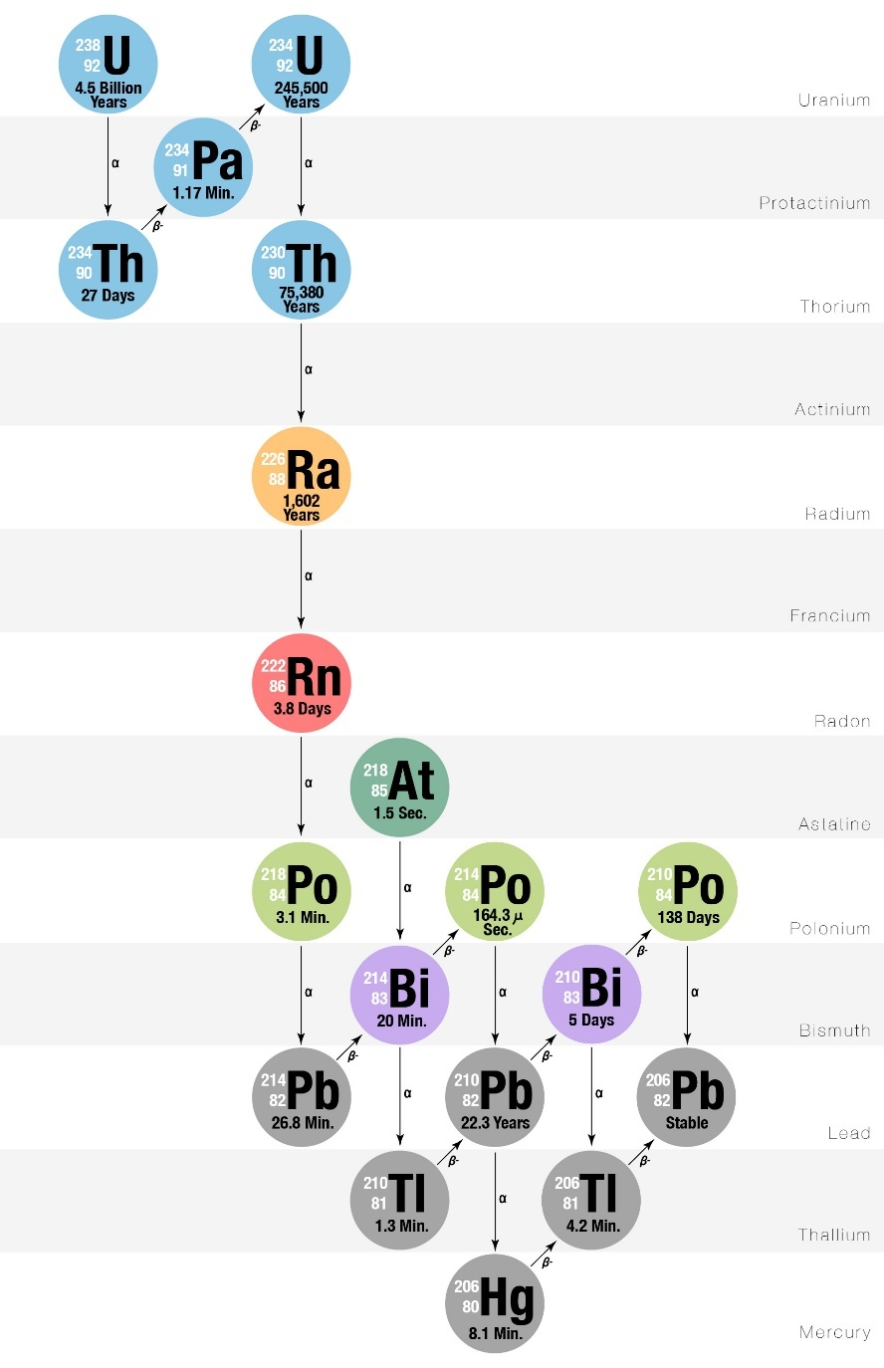
Is Radon in Groundwater Dangerous?
Gas at room temperature
Colourless
Odourless
Tasteless
Very dense compared to air
Half life of 3.8 days
Dangerous daughters!

Slide 5
Is Radon in Groundwater Dangerous? 2

Slide 6
WIFHC 2017 Regs
Is Radon in Groundwater Dangerous?
Parametric Value 100Bq/l (PCV)
Threshold Value 1000Bq/l

Slide 7
Is Radon in Groundwater Dangerous? 3
1,000l ground water containing 100Bq/l pumped into storage tank
Assuming all radon gas escapes from water
Ra
Ra
Ra
1,000l X 100Bq/l = 100,000Bq of Radon in the Shed
2m
Shed volume is 10m³
Therefore 10,000Bq/m³ in the shed
2m
The Action Limit is 300Bq/m³
2.5m
This is over 32 times the limit!

Slide 8
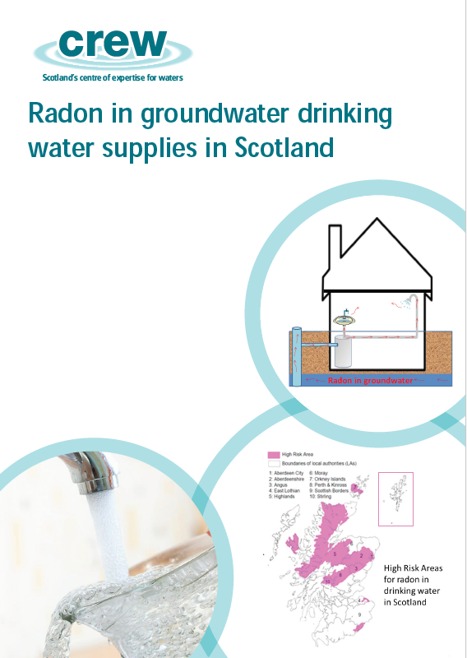
Existing Literature
Is Radon in Groundwater Dangerous?
DWQR “Radon – Guidance for Local Authorities”
Water UK “Radon in air – Occasional guidance note”

Slide 9
Risk Assessment (IRR 97)
Is Radon in Groundwater Dangerous?
28 high risk sites identified
9 exceeded 300Bq/m³ (highest 24,000Bq/m³)
Considered staff by role & duration
Worst case 0.39 milliSv (limit 1 milliSv)

Slide 10
Mitigation - Design Considerations
Is Radon in Groundwater Dangerous?
Passive Venting
External tank overflow
Sealed lids

Slide 11
Mitigation – Working Practices
Is Radon in Groundwater Dangerous?
Extractors
Wait!
Leave doors open

Slide 12
Mitigation - Treatment
Is Radon in Groundwater Dangerous?
Avoid adsorption media such as Activated Carbon or Bonechar due to NORM accumulation

Slide 13
Summary
Is Radon in Groundwater Dangerous?
Radon in groundwater is not a problem…
…and thankfully Radon in air is a manageable problem!
Q & A

