Slide 1
The Hierarchy of Private Water Supplies
Introduction
Let’s talk about Nigel
The Source of Nigel’s problems
Nigel’s Options
Nigel’s L.A.
Summary

Slide 2
Introduction
The Hierarchy of Private Water Supplies
My Background
HighWater

Slide 3
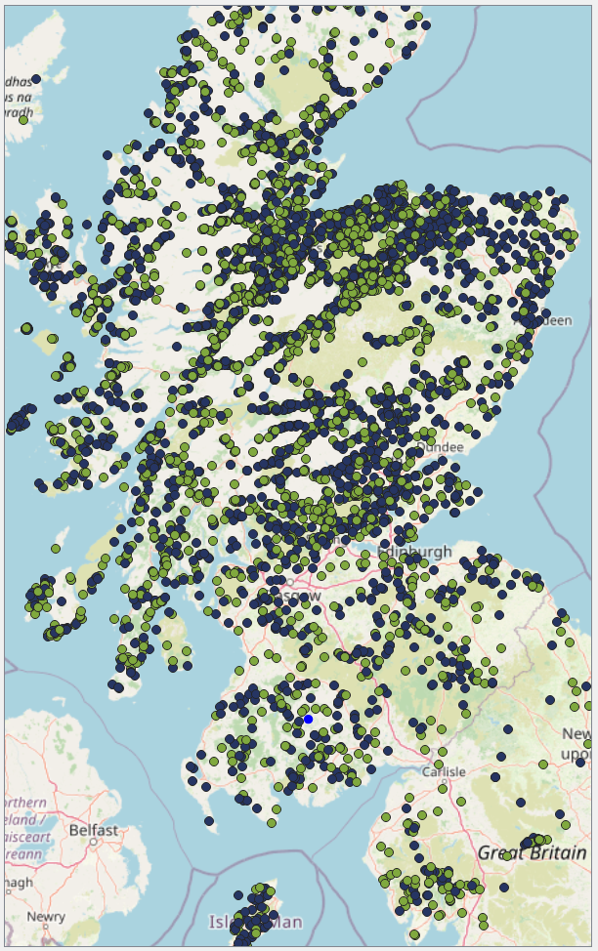
Client Coverage
The Hierarchy of Private Water Supplies

Slide 4
Let’s talk about Nigel
The Hierarchy of Private Water Supplies
The phone call
The Regulations
The Risk Assessment

Slide 5
The Source of Nigel’s problems
The Hierarchy of Private Water Supplies
The Hierarchy:
Mains Water
A true spring (?)
Borehole
Surface supply (stream, loch, pond, ditch, RWH, shallow well)

Slide 6
Nigel’s Options
The Hierarchy of Private Water Supplies
Improve the source
Establish a borehole supply
Manage expectations
Complete design & installation

Slide 7
Nigel’s L.A. - Considerations
The Hierarchy of Private Water Supplies
Water Storage Tank – Size?
20 micron?
WSP
UV Alarm
Lamp Fail / Power Fail (?)
Audio/Visual/Solenoid Shut-off (?)

Slide 8
Summary
The Hierarchy of Private Water Supplies
Is Nigel happy?

Slide 9
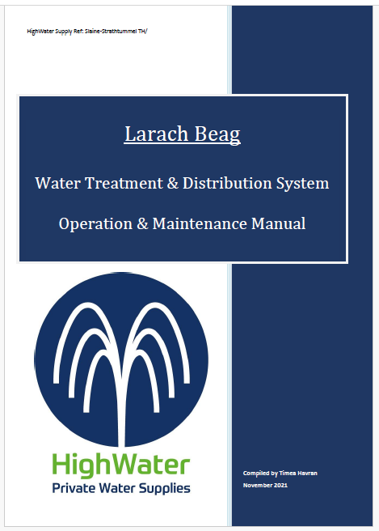
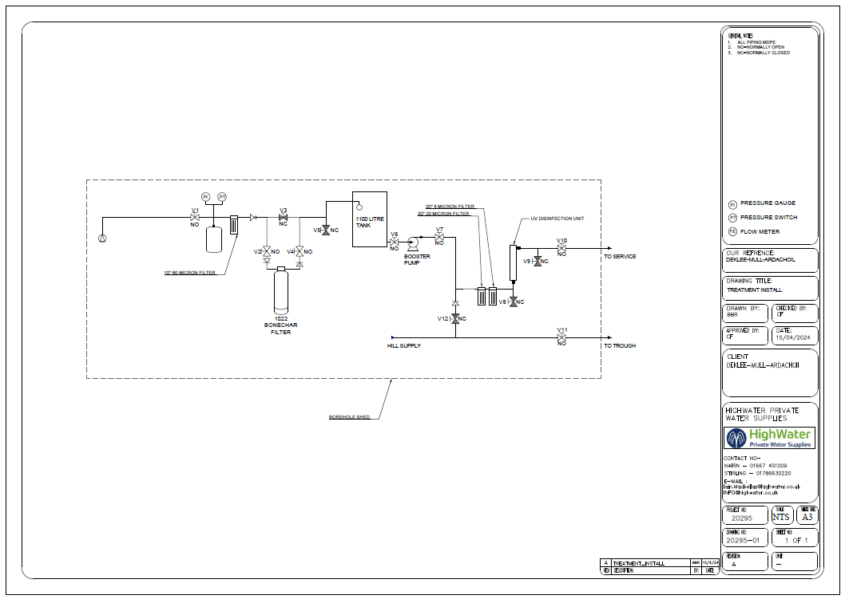
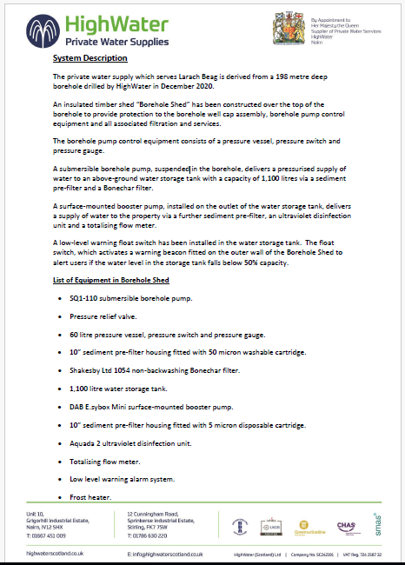
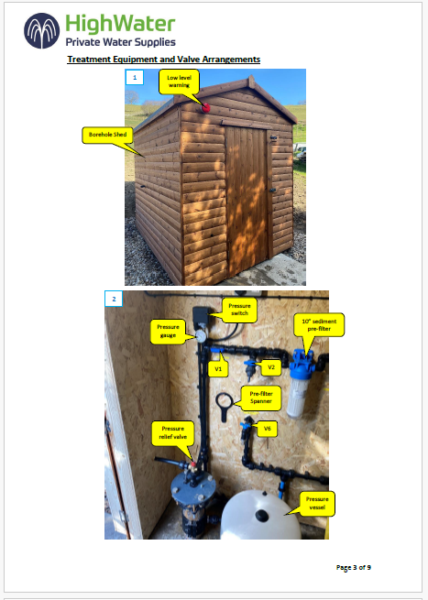
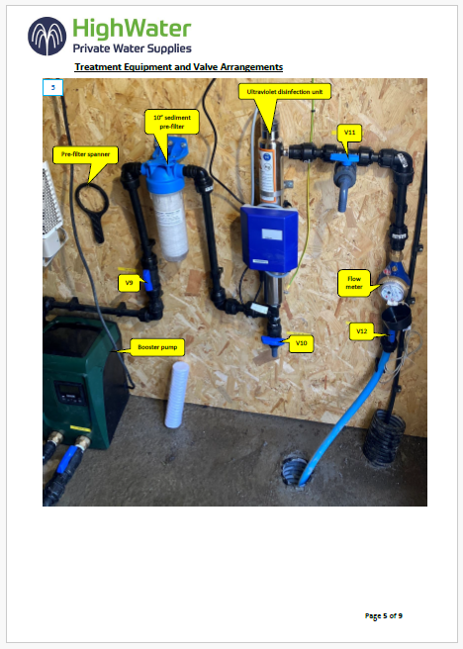
The Hierarchy of Private Water Supplies 1

Slide 10
Summary
The Hierarchy of Private Water Supplies
Q & A
Spare Oasis tickets? (asking for a friend)

Slide 11
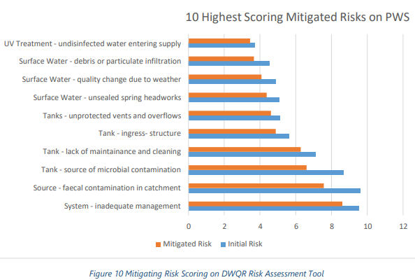
The Hierarchy of Private Water Supplies 2

